Slide 1
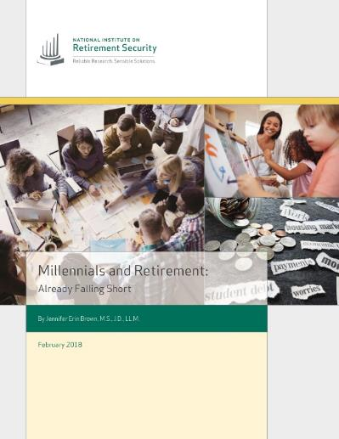
Millennials and Retirement:
Already Falling Short
Ninth Annual NIRS Policy Conference
February 27, 2018
Jennifer Brown, Manager of Research

Slide 2
Two-Thirds Of Working Millennials Have Nothing Saved For Retirement

Slide 3
Of The One-Third Of Millennials Who Are Saving For Retirement, Only 14.2% Are Saving Adequately

Slide 4
Two-Thirds Of Millennials Have Access To A Plan, But Only One-Third Participate
Access
Participation

Slide 5
There Is A Significant Gap In Participation Between Millennial Latinos And Other Communities
Access
Participation

Slide 6
Four Out Of Ten (40.2%) Millennials Cited Eligibility Requirements As Why They Did Not Participate In A Plan

Slide 7
Millennials’ High Take-Up Of Employer-Sponsored Plans Gives Hope For This Generation

Slide 8
Millennials In Public Safety, Health Care, and Education Have The Highest Access To Plans

Slide 9
Policy Recommendations To Improve Retirement Savings For This Generation
Expand eligibility for part-time workers
Reduce waiting periods and allow workers to contribute immediately when they are hired
Increase auto-enrollment into plans by employers
Increase employer matches and default contribution rates
Provide education to increase awareness about the benefits of an employer match
Promote the Federal Saver’s Credit
Protect and strengthen Social Security

Slide 10
Summary Of Findings On Millennials And Retirement Savings:
Two-thirds (66.2%) of working Millennials and 83% of working Millennial Latinos have nothing saved for retirement.
Using the recommendations of financial experts, only five percent of working Millennials are saving adequately for retirement.
Even though two-thirds (66%) of Millennials work for an employer that offers a retirement plan, only slightly over one-third (34.3%) of Millennials participate in their employer’s plan, because they are not eligible.

