Slide 1
Teacher Pension Research
Presentation to National Institute on Retirement Security
February, 2018

Slide 2
Selected Teacher Pension Research
Better Bang for the Buck – Economic Efficiencies of DB Plans – Beth Almeida & Fornia – 2008
Still a Better Bang for the Buck – Fornia & Nari Rhee – 2014
Are California Teachers Better off with a Pension or 401(k) – Rhee & Fornia – 2016
How Do California Teachers Fare Under CalSTRS – Journal of Retirement – Rhee & Fornia 2017
http://www.iinews.com/site/pdfs/iiJPDF/PensiontrustAd/PensionTrusteeAdvJORWint17CaliTeachersFare.pdf

Slide 3

Better Bang for The Buck
And Still a Better Bang for the Buck
Conclusion – Can provide about the same amount of benefits from DB as DC for half the cost
  DB can predict group longevity better than an individual can predict own longevity
  Professionally managed DB assets earn higher return
  Individuals must shift to less risk/reward investments as they age
Notes:
3

Slide 4
Opposing Views
Better Pay, Fairer Pensions: Reforming Teacher Compensation – Manhattan Institute (McGee & Winters) 2013
  Teachers would be better off with 401(k)
  Many don’t stay long enough for DB value to exceed
  Money could be better spent on compensation
Notes:
4

Slide 5
California Teacher Pension Research
Flaws in Opposing Research
  Even though some teachers turnover, they are not the ones doing the teaching
  DB Benefit Value vs. DC needs to reflect findings from Bang for the Buck
  CalSTRS has particularly strong benefits for early terminators
Notes:
5

Slide 6

Are California Teachers Better off with a Pension or a 401(k)?
Nari Rhee, PhD
UC Berkeley Center for Labor Research and Education
NCTR/NIRS Webinar
February 9, 2016
EXCERPTS FOR NIRS POLICY CONFERENCE 2018

Slide 7
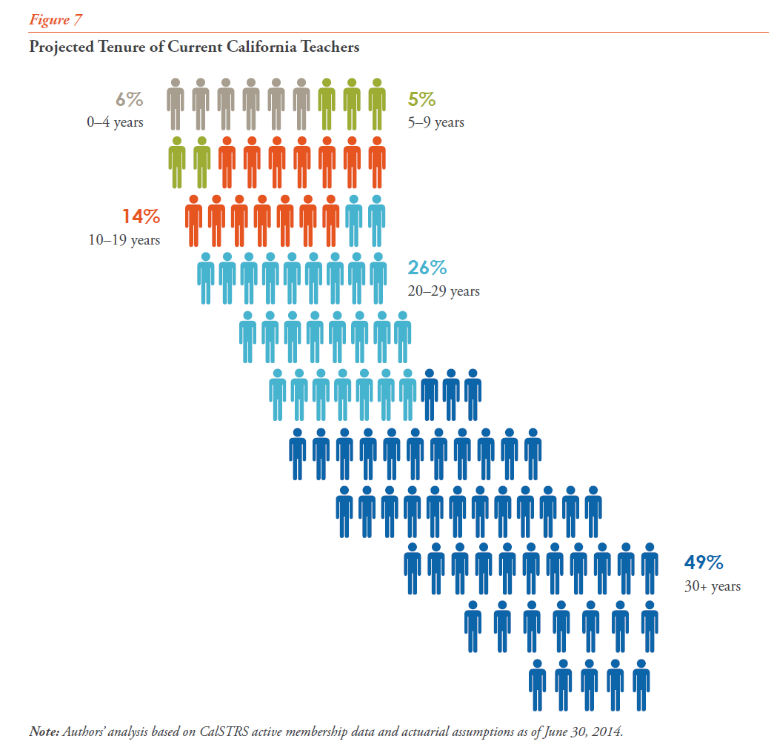
1) Most classroom teaching in CA is performed by long-career teachers who are well-positioned to benefit from a traditional pension.
3 out of 4 current teachers will retire with at least 20 years
of service*.
About 1/2 will retire with at least 30 years.
Median age at exit: 61, with 29 years of service.
* FT and PT treated equally for service year calculation purposes

Slide 8
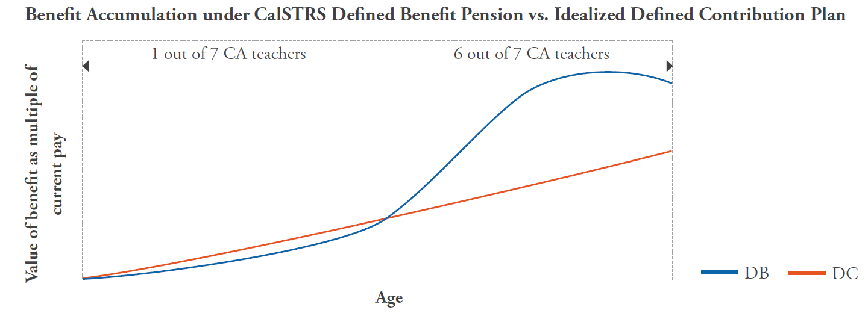
When Tenure Is Considered in Tandem with Benefit Accrual Patterns, Vast Majority of CA Teachers Are Better off with CalSTRS Pension

