Slide 1
Pensions Work Best For Our Schools, Communities And Educators – Now And In The Future
Michael Hairston
Senior Pension Advisor

Slide 2
Pensions Work Best for Our Schools and Students
Having experienced teachers in our nation’s K-12 classrooms is key to providing our children a quality education.
Pensions are a big part of that story, providing both a push and pull, in regard to the Three R’s of managing a school’s staffing: recruiting, retaining, and retiring.
Communities have enjoyed the outcomes of the current system, where it remains common for teachers to spend decades involved in their communities.

Slide 3
Pensions Work Best for Our Schools and Students
Pension plans are also comprehensive, providing disability benefits, death benefits, and often cost-of-living adjustments.
The short-timers who leave their profession before reaching vesting still get their contributions back with interest just like in a 401k.

Slide 4
Pensions Work Best for Educators
Yet, powerful, moneyed interests continue pushing for plans that reward educators who stay for just a few years and disadvantage career educators. Put simply, they make teaching more of a drive-thru service.
Thanks partly to pensions, teachers do not typically act like free agents – constantly hopping to new jobs. The goal of making teaching a revolving door job is simply misguided.

Slide 5
Pensions Work Best for Educators
Pension plans are also comprehensive, providing disability benefits, death benefits, and often cost-of-living adjustments.
The short-timers who leave their profession before reaching vesting still get their contributions back with interest just like in a 401k.

Slide 6
Pensions Work Best for Our Communities and Taxpayers
Pensions are more efficient than 401k plans, providing about twice the value per dollar invested, with higher returns, lower fees, and utilizing pooling investment and longevity risks.
Offering new educators a 401k-type plan with similar benefit levels would increase costs significantly.

Slide 7
Pensions Work Best for Our Communities and Taxpayers
While providing economic security to retirees, pensions also support our economy by generating $1.2 trillion in economic activity and supporting 7.1 million jobs and increasing GDP by $627 billion. Each $1.00 of benefits supports $2.21 in economic security.
Only 24.1% of pension revenues came from taxpayers between 1993-2014, with most of the financial support coming from investment returns and employee contributions.

Slide 8
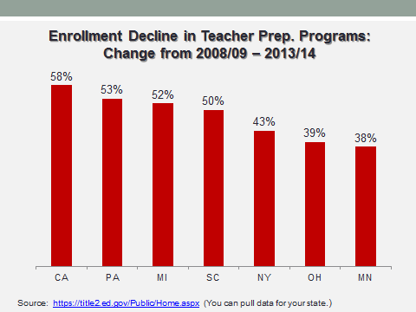
Pensions Work Best as We Face Teacher Shortages
With more states facing teacher shortages, pensions make education careers attractive to prospective educators, as well as keep great teachers in the classroom.

