Slide 1
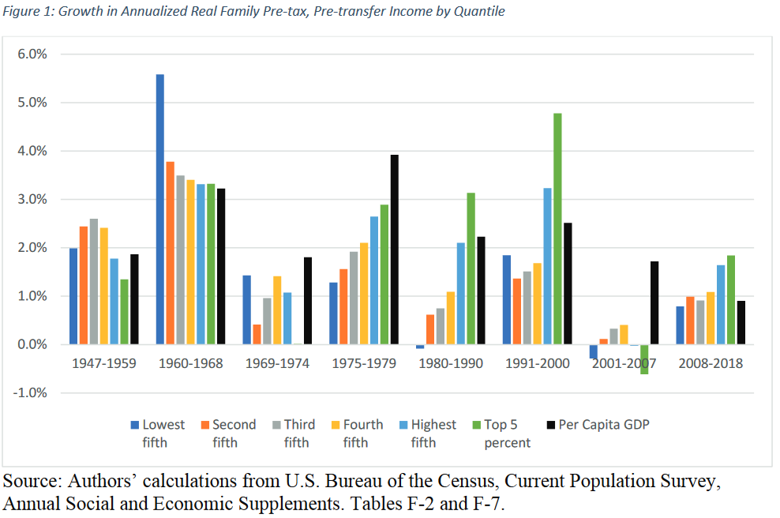
Since 1975, Income Growth Has Been Concentrated at the Top
Source: Rand Working Paper, Trends in Income from 1975 to 2018

Slide 2
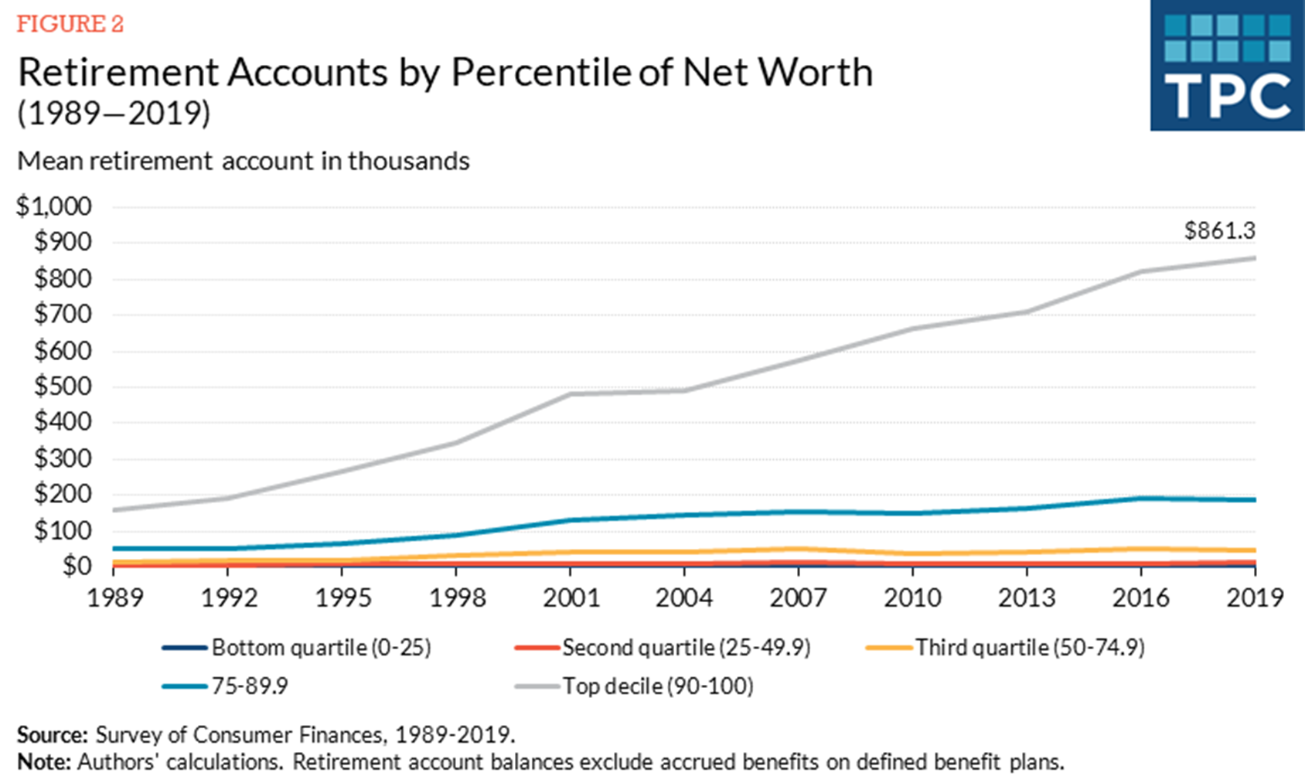
Money in Retirement Accounts is Concentrated at the Top
Source: Steve Rosenthal, Tax Policy Center

Slide 3
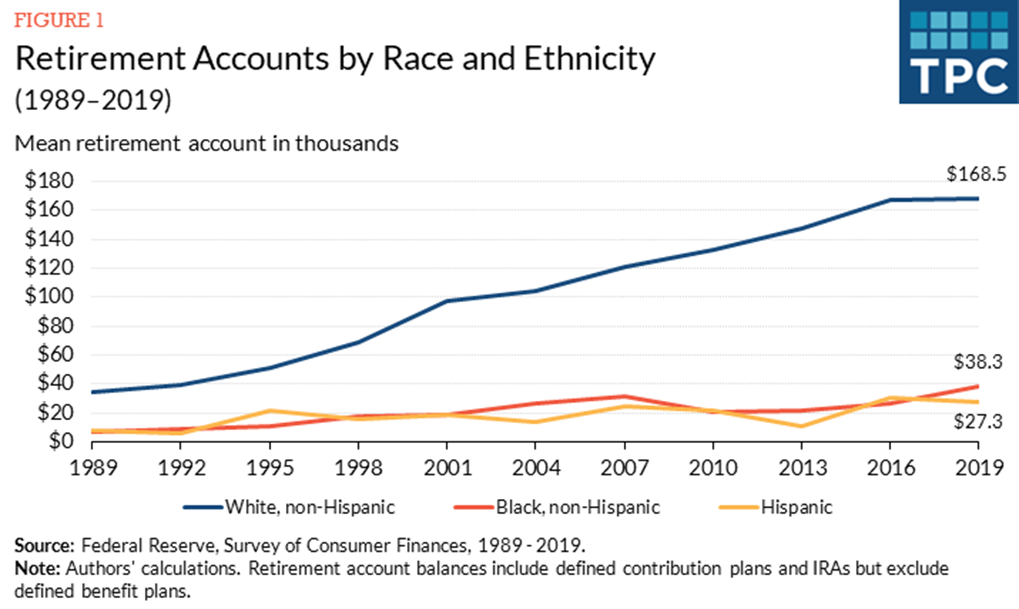
Money in Retirement Accounts is also Concentrated by Race
Source: Steve Rosenthal, Tax Policy Center

Slide 4
Higher Income Families Are More Likely to Have Tax Benefits for Retirement
Source: U.S. Treasury, Office of Tax Analysis

Slide 5
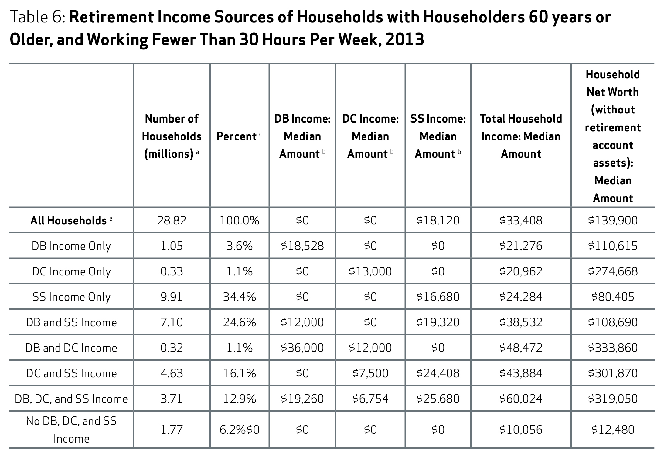
Those with Income from DC Plans Tend to Have Higher Net Worth Than Those Without
Source: NIRS, Examining the Nest Egg

