Slide 1

The Value of a Good Pension:
The business case for good workplace retirement plans
NIRS 13th Annual Retirement Policy Conference
Tuesday, March 1, 2022
1:50 p.m. – 2:20 p.m. EST
Darryl Mabini
Assistant Vice-President, Stakeholder Engagement & Research, Healthcare of Ontario Pension Plan (HOOPP)

Slide 2


Who we are –
Healthcare of Ontario Pension Plan (HOOPP)
Net assets
Funded status
Rate of return for 2020
10-year annualized rate of return
$104
119%
11.42%
11.16%
billion
Total number of members
Total number of employers
400,000+
614

Slide 3

New report
The business case for good workplace retirement plans
HOOPP believes in research that promotes retirement income security. Our advocacy for Canada-model plans, like HOOPP, is meant to highlight the characteristics which make these plans successful
In November 2021, HOOPP and Common Wealth launched new research: The Value of a Good Pension: The business case for good workplace retirement plans, demonstrating the value of good retirement plans for employers
Notes:
Why HOOPP does research:
Provide unbiased information and research about retirement and pensions
Highlight public demand for more accessible and affordable retirement programs for every Canadian
Driving to consensus by engaging governments and stakeholders in constructive discussions to identify practical solutions
Advocate for regulatory modernization and innovation in the pension industry

Slide 4
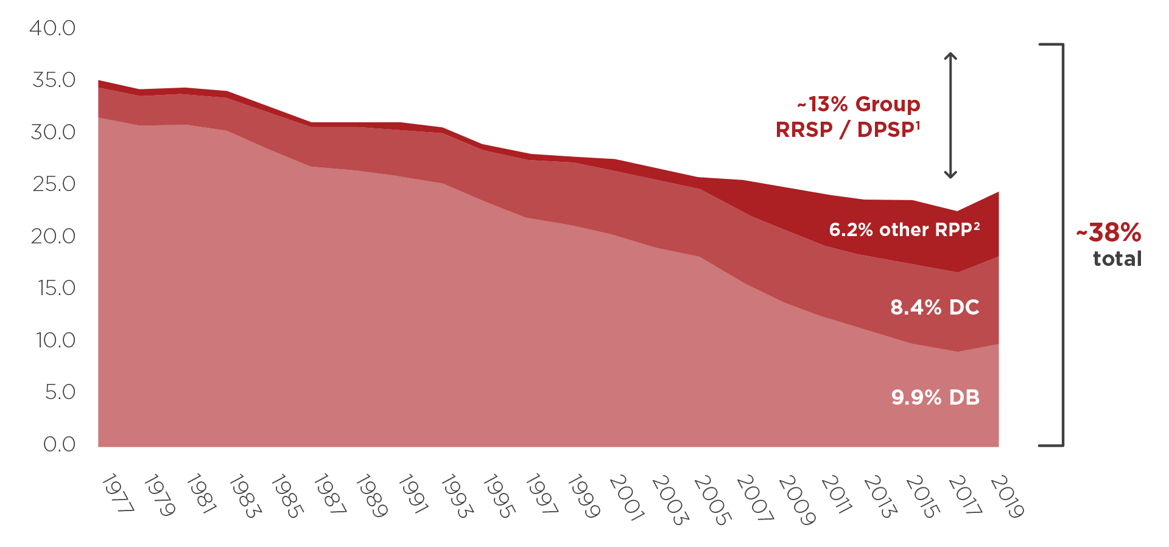
DB pension coverage in the Canadian private sector has declined to a third of 1970s levels
Proportion of private sector workers participating in a workplace retirement plan in Canada 1977-2019
While the overall level of coverage has remained steady, at slightly over a third of the private sector workforce, the changes in the types of plans provided has effectively shifted risk from the employer to the employee.
¹ Based on findings from 2016 Survey of Financial Security that there were 1.6 million Group RRSP and DPSP members in Canada. Trend series unavailable. Coverage estimate assumes that all Group RRSP and DPSP members are outside the public sector.
² Includes members of: Hybrid plans (benefit is the better of that provided by defined benefit or defined contribution provisions); Composite or combination plans (pension has both defined benefit and defined contribution characteristics); “DC and DB” (may be for different classes of employees or one benefit type may be for current employees and the other for new employees)
Sources: Statistics Canada, Pension Plans In Canada Survey, Labour Force Survey, Percentage of paid workers covered by a registered pension plan; OSFI Registered Pension Plans (RPP) and Other Types of Savings Plans 2017
Notes:
"... transferring cost of retirement to individuals and ultimately taxpayers."
US trends:
Among all private-sector workers, 68% had access to either a DB or DC plan (or both) in 2021; Among these workers, 15% had access to a DB plan, 65% had access to a DC plan, and some had access to both.
Distribution of assets by OECD country: Canada (5.7%); US (65.6%)
State retirement systems are now over 80% funded for the first time since 2008 (in 2021); Mercer Pension Index (Canada)
Aging population in US; Normal retirement age for those aged 62 (2022): 67
About 62% of businesses with a 401(k) automatically enroll workers into the retirement plan, according to the Plan Sponsor Council of America; 2020 was the first year employers most commonly used a 6% “deferral” rate, rather than 3%.
Potential changes by Congress (House Bill: Securing a Strong Retirement Act — nicknamed “Secure 2.0”; Senate Bill: Retirement Security and Savings Act); Required minimum distributions, student loan debt impeding retirement savings, part-time worker eligibility for 401(k) plans, automatic enrollment, and expanded “catch-up” contributions for older savers.
61% of Canadian DB funds are in a surplus position (LINK: https://www.mercer.ca/en/newsroom/db-pensions-well-funded-q4-2021.html) - The Mercer Pension Health Pulse tracks the median ratio of solvency assets to solvency liabilities of the pension plans in the Mercer pension database, a database of the financial, demographic and other information of the pension plans of Mercer clients in Canada.

Slide 5




Good workplace retirement plans can create long-term value for businesses
Business case for good workplace retirement plans
Compensation
efficiency
Talent attraction and retention
Reduced
financial stress
ESG considerations
Notes:
Workplace retirement plans should not be solely viewed as a cost, but as an investment as well. How, though, should employers construct a business case to evaluate such investments?
A framework based on four elements:
Compensation Efficiency:
Talent attraction and retention:
Reduced financial stress:
ESG considerations:

Slide 6
Business case for good workplace retirement plans
Compensation
efficiency
Talent attraction and retention
Reduced
financial stress
ESG considerations

Slide 7






6 key drivers of value in retirement arrangements
Investment
discipline
Saving
Fees and costs
Fiduciary
governance
Risk pooling
Portability
Notes:
“Recall back to the original Value of a Good Pension research…”
The first three value drivers can be applied by any individual saving for retirement, as well as anyone in a collective savings arrangement. The last three drivers are generally more of a benefit of collective savings arrangements, but considering the impact they can have, there is clearly work required to make them more accessible to all Canadians.
When used in combination, the five value drivers can significantly enhance your ability to save for retirement.

Slide 8
Calculations show significant differences in efficiency between retirement arrangements
More individual
More collective
 | Typical individual approach | Small-employer capital accumulation plan | Large-employer capital accumulation plan | Large-scale pooled plan | Canada-model pension plan
How much does retirement cost?* | $1.20M | $1.05M | $0.79M | $0.39M | $0.31M
What is my retirement “bang for buck”?** | $1.70 | $1.94 | $2.58 | $4.19 | $5.32
In Canadian Dollars ($CAD)
*Total contributions required to achieve a 70% replacement rate for a worker earning $40K at the start of her career
**Total retirement income, plus assets remaining at death divided by total lifetime contributions
Notes:
When looking at “value for money” - Lifetime contributions required to achieve 70% replacement rate for a typical worker is 4x less expensive in a Canada-model pension plan
When these drivers are used in combination, the average individual could see their cost of retirement reduced by almost $900,000.

Slide 9

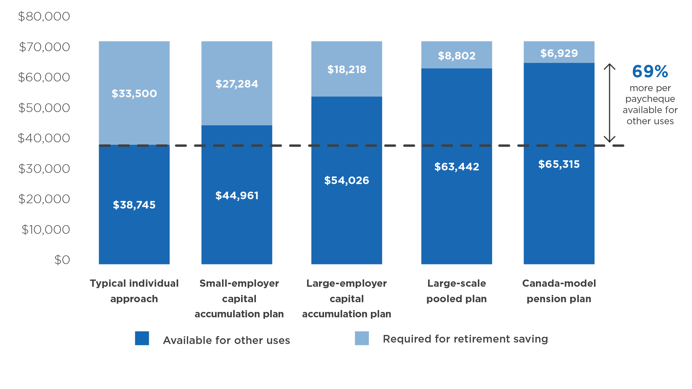
Good retirement plans offer significantly more efficient compensation
Share of worker’s annual pay required for retirement saving vs. available for other uses
In Canadian Dollars ($CAD)
Notes:
When an employer offers a Canada-model pension plan rather than no pension plan at all, a representative worker could increase their pay available for other uses (i.e., not retirement) by an average of 69%, or about $26,600 per year. Workers in high-quality plans can thus take home more in pay each year without sacrificing their retirement security.

Slide 10

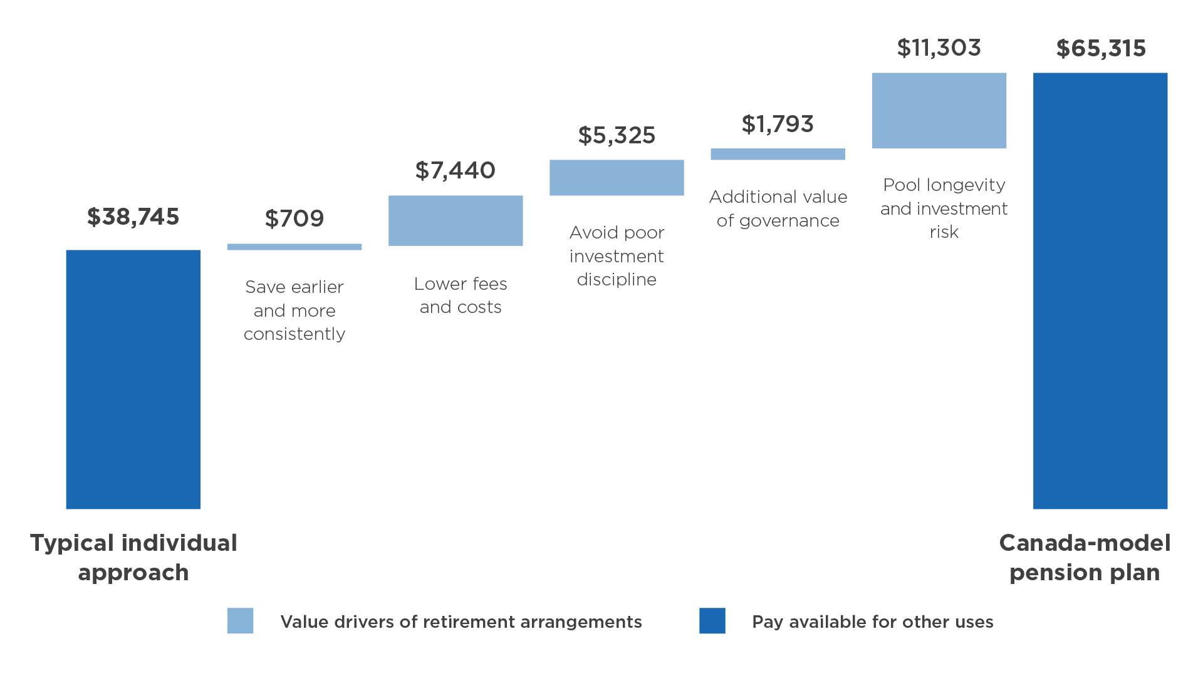
Employers and employees can get
better bang for their collective buck
How the value drivers contribute to greater compensation efficiency
In Canadian Dollars ($CAD)
Notes:
This chart breaks down the contribution of each of the five value drivers to the $26,570 difference in pay available for other uses by Sophia, between the typical individual approach and the Canada-model pension plan. There is significantly more compensation efficiency through workplace retirement models on the right end of the spectrum. Workers in high-quality plans can take home thousands of dollars more in pay each year without sacrificing their retirement security.
Similar to NIRS’ “Better Bang for your Buck” research, by pooling longevity and investment risk, avoiding poor investment decisions, and taking into account the impact of fees and costs, both employers and employees enjoy better value for their money without sacrificing their income security.

Slide 11
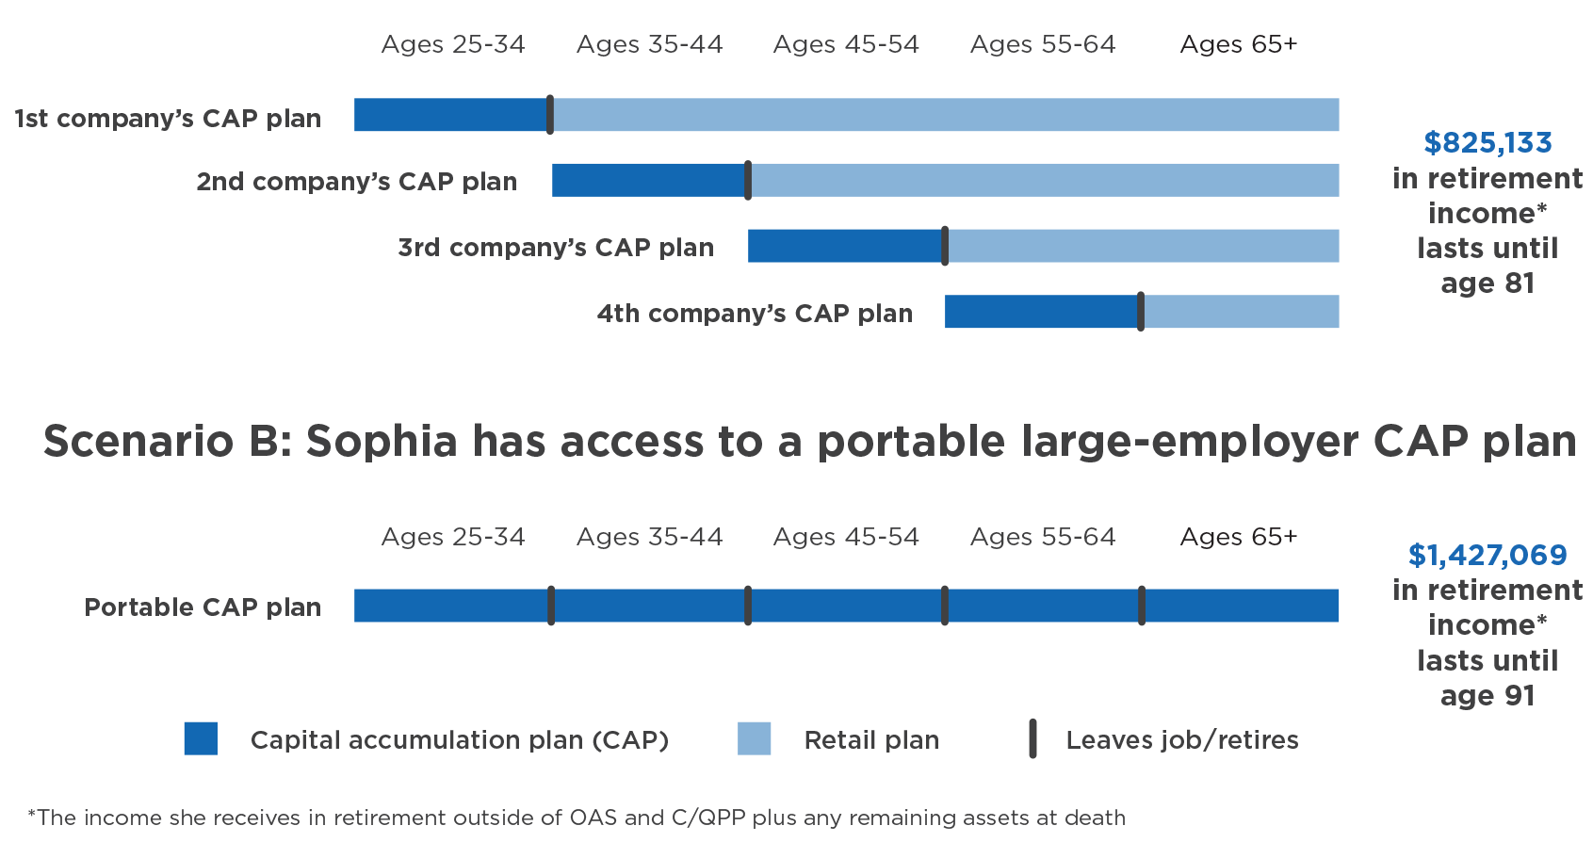
Portability of retirement plans increase
retirement income and security
The portability of a workplace retirement plan can mean that the same amount of savings leads to a materially different level of retirement security.
Notes:
The same amount of savings yields Sophia retirement income that lasts only until age 81 without portability, compared to age 91 with full portability.
In portable retirement plans, members enjoy continued access to their plan features (e.g. same savings behaviour, fees and costs, investment discipline, governance structure, risk pooling drivers) upon leaving their job or retiring.
In nonportable retirement plans, members who leave their company or retire often do not have continued access to their workplace retirement plans and their existing plan assets are “rolled over” into higher cost retail plans

Slide 12
Business case for good workplace retirement plans
Compensation
efficiency
Talent attraction and retention
Reduced
financial stress
ESG considerations

Slide 13
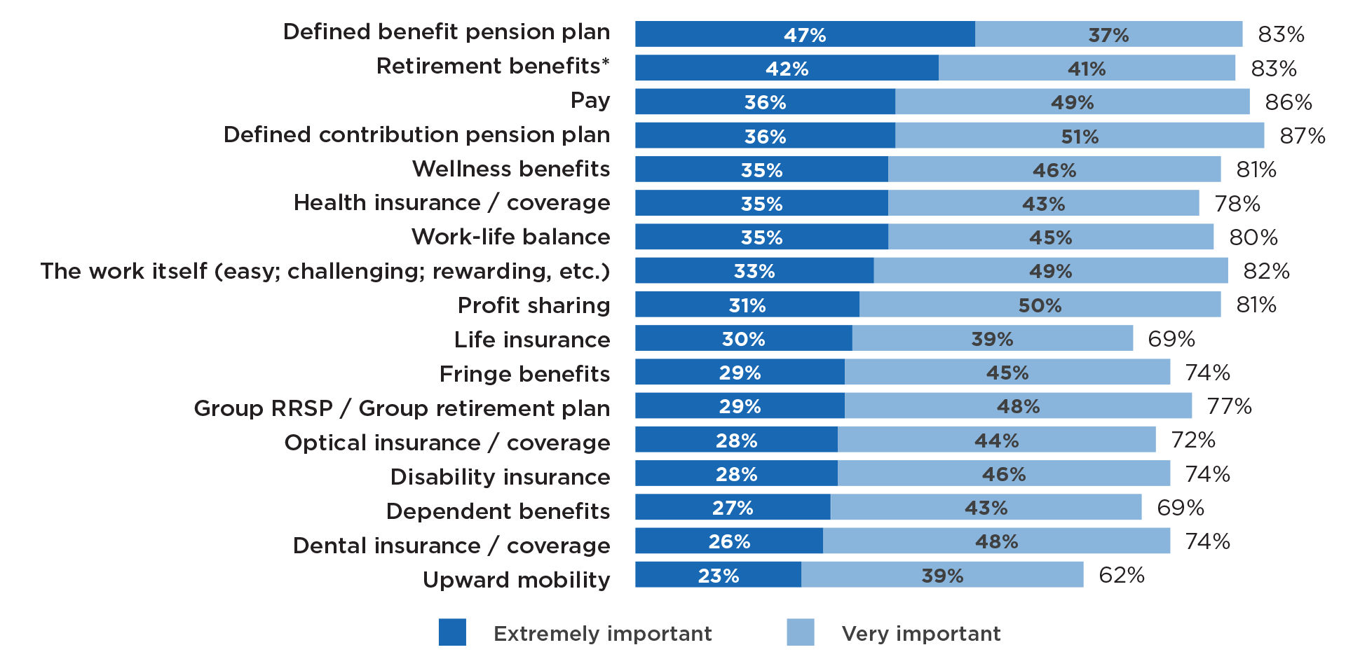
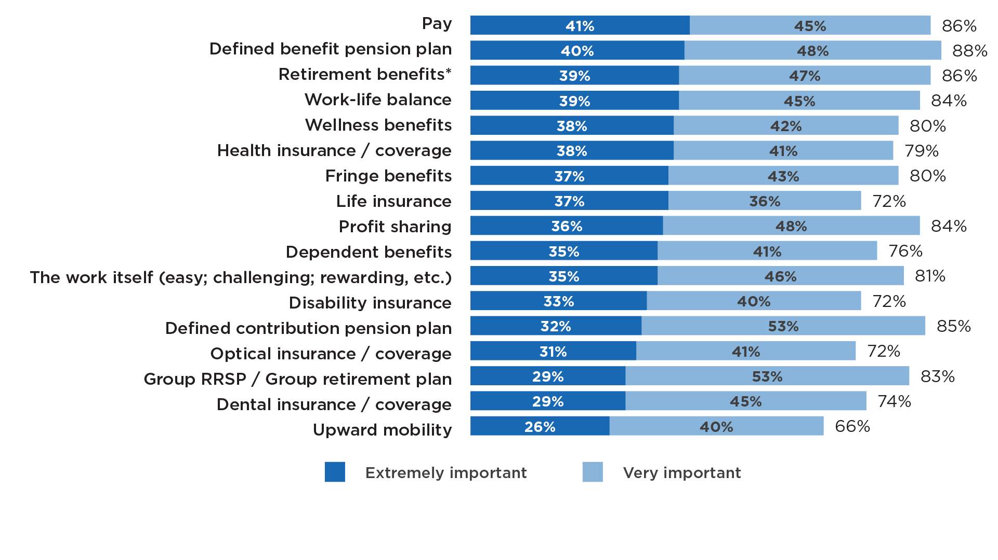
Offering a workplace retirement plan
delivers ROI to employers
Importance for recruitment
(among businesses providing benefits)
Importance for retention
(among businesses providing benefits)
* Defined benefit, defined contribution or Group RRSP / Group retirement plan
* Defined benefit, defined contribution or Group RRSP / Group retirement plan
Sources: Maru/Matchbox. Commissioned by Healthcare of Ontario Pension Plan (HOOPP), "Canadian Employer Pension Survey" (October 2021).
https://hoopp.com/docs/default-source/about-hoopp-library/advocacy/2021-canadian-employer-pension-survey-report-presentation-deck.pdf
Notes:
83% of employers offering a defined benefit pension plan said it was “extremely important” or “very important” to recruitment (with 47% saying it was “extremely important”)
88% of employers offering a defined benefit pension plan said it was “extremely important” or “very important” to retention (with 40% saying it was “extremely important”)
Between 77% and 87% of employers who currently offer the benefit said a workplace retirement plan was extremely important or very important for recruitment.
A study from Manulife found that 86% of employees who belong to a workplace group retirement plan agreed these benefits increase retention, with 82% of the same employees agreeing they increased their loyalty to their respective employers.
Bell Canada – one of the largest telecom companies in Canada stated that one of the primary reasons the company has offered and continues to offer retirement benefits, which they’ve been doing since the 1920s, is to help attract, retain and motivate its employees.

Slide 14
Business case for good workplace retirement plans
Compensation
efficiency
Talent attraction and retention
Reduced
financial stress
ESG considerations

Slide 15

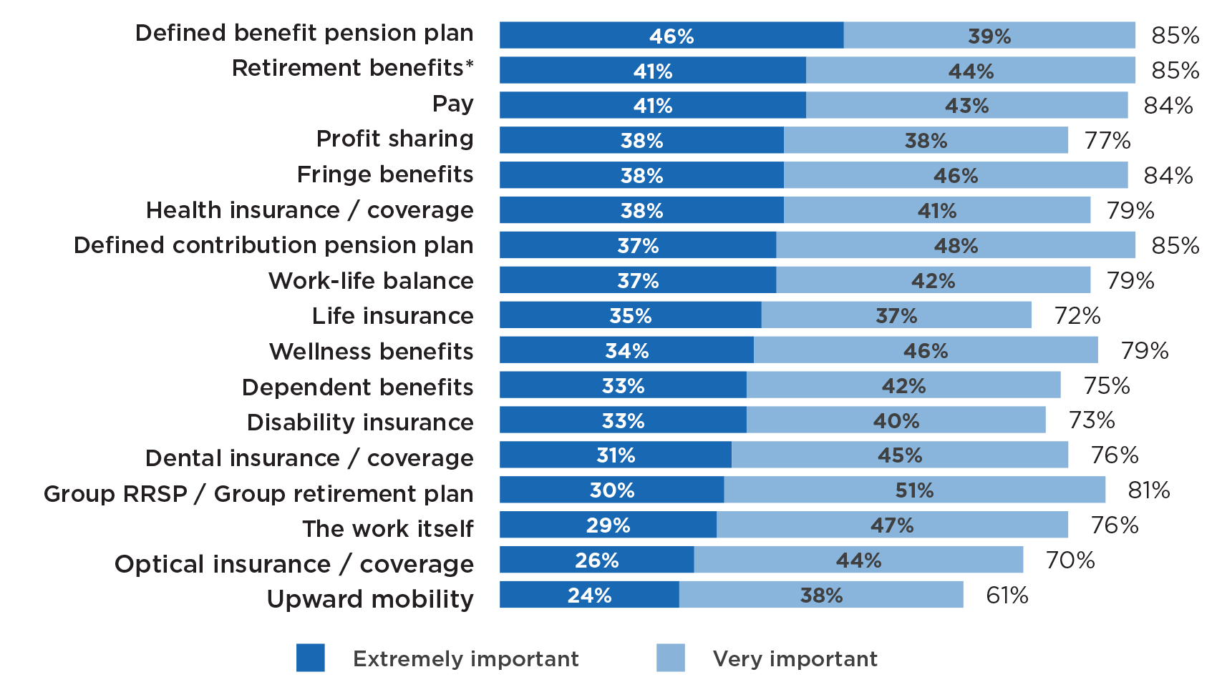
Workplace retirement plans reduce
financial stress for employees
Importance for reducing financial stress (among businesses providing benefits)
* Defined benefit, defined contribution or Group RRSP / Group retirement plan
Source: Maru/Matchbox. Commissioned by Healthcare of Ontario Pension Plan (HOOPP), "Canadian Employer Pension Survey" (October 2021).
https://hoopp.com/docs/default-source/about-hoopp-library/advocacy/2021-canadian-employer-pension-survey-report-presentation-deck.pdf
Notes:
Employers ranked workplace retirement plans among the top ways to reduce financial stress, comparable to pay and fringe benefits, and above wellness benefits, health insurance, disability insurance and life insurance.
As with recruitment and retention, retirement plans that tend to incorporate more value drivers were more likely to be regarded as “extremely important” to reducing financial stress, with defined benefit pension plans being the benefit most likely to be regarded as such.
According to the Canadian Payroll Association, financial stress is costing Canadian employers approximately $16 billion annually due to lost productivity.

Slide 16
Business case for good workplace retirement plans
Compensation
efficiency
Talent attraction and retention
Reduced
financial stress
ESG considerations

Slide 17
Assuming a voluntary system, how to encourage greater access to quality retirement plans?

Slide 18



Areas to explore – for stakeholders
For government, business and pension industry
Employer-level auto features (enrolment, escalation)
Encourage portable, multi-employer plans outside the public sector
Increase availability of longevity insurance and other forms of risk pooling within workplace plans
Incorporate decumulation options into capital accumulation plans
Help plan sponsors and members understand value for money

Slide 19

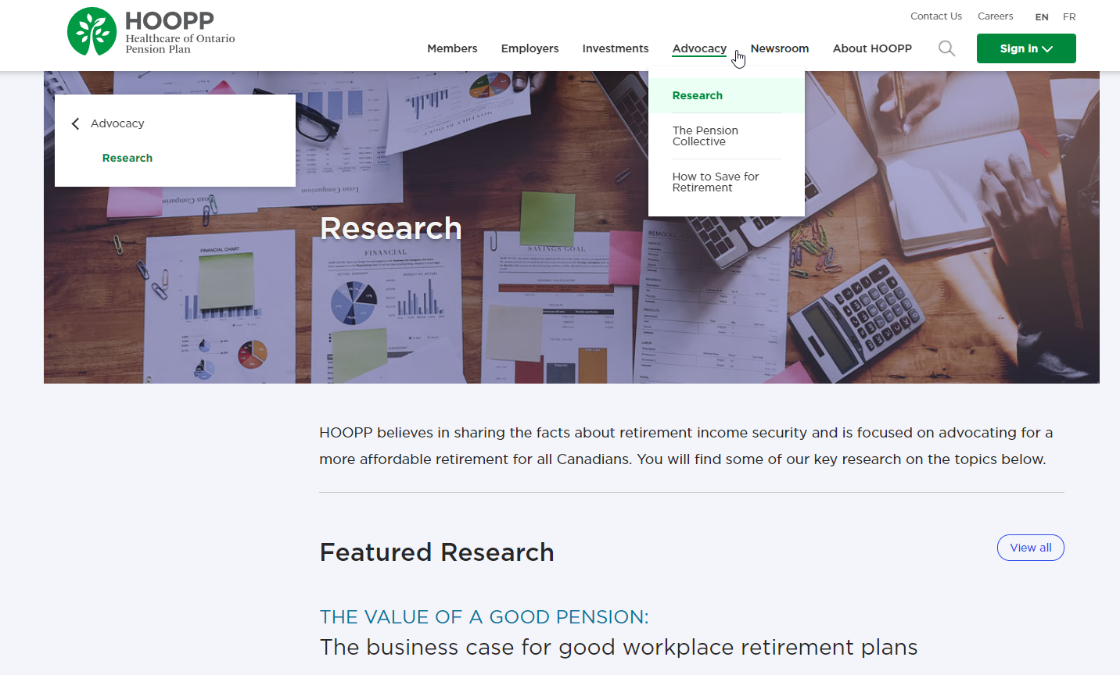
Research at HOOPP
Visit hoopp.com to find more
Notes:
Canadian Public Pension Leadership Council – a consortium of defined-benefit pension plans in Canada
Canadian Centre for Economic Analysis studied the economic contribution public sector pension plans bring to the local economies in Canada
The economy of every community in Canada is positively impacted by public sector pension plan activity, whether through the work of active members and their employers, retired members’ pension-related spending, or through the local investment activities that pension plans perform on behalf of their members. The study looks at plans with $1.27 Trillion in assets under management representing 1,233 public sector plans
The National Institute on Aging (NIA) in Canada – a think-tank focused on the realities of Canada’s ageing population.

Slide 20
Thank you

