Slide 1

E also
Reserve Fund Stabilized Contribution Policy:
A Model Public Pension Funding Policy
National Institute on Retirement Security
Annual Conference
March 1, 2022
David Draine, Senior Officer
Strengthening Public Sector Retirement Systems

Slide 2
Key Steps for Improving Funding Policy
Ask the right questions
Learn from states
Model volatility

Slide 3
Finding a better funding policy
Standard actuarial funding practices have led to volatile contribution levels following recessions and market corrections.
States and local governments that fall short of minimum actuarial standards have been in even worse shape.
Volatile contributions make budget planning difficult and crowd out important public investments.
The challenge—identify funding approaches that reduce cost volatility and preserve intergenerational equity without sacrificing solvency and plan funding.

Slide 4
Current practice can handle the expected
If everything meets expectations, typical plan funding will allow for stable employer costs.

Slide 5
But not the unexpected
Standard actuarial funding practices can lead to unpredictable costs given the volatility of public pension plan investments.

Slide 6
Using a reserve fund to stabilize funding
The proposed funding policy builds on current actuarial best practices on funding by adding a reserve fund to stabilize employer contributions.
When the plan is fully funded, the plan sponsor will contribute more than the employer normal cost, with the excess going into a reserve fund.
When there is a downturn or actuarial shock, some or all of the increase in needed contributions will come from the reserve fund rather than from the plan sponsor.
At no time does the plan receive less than the actuarial contribution rate from the plan sponsor and the reserve fund, preserving funding levels.
The key tradeoff—higher employer contribution rates if everything goes as expected in exchange for greater predictability in the case of a downturn.

Slide 7
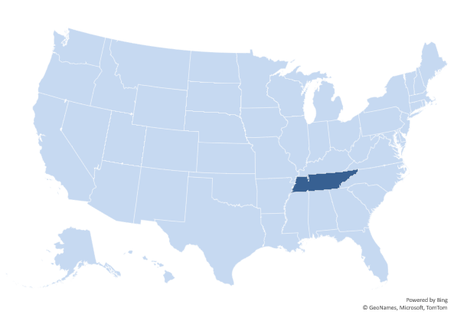
Tennessee’s pension reserve fund
Following the Great Recession, Tennessee adopted a hybrid plan design for new hires. This plan would ensure predictable costs through the combination of a reserve fund, variable benefits, and by providing a portion of benefits through a DC account.
How the TN reserve fund works:
Every participating employer will contribute 4% of payroll for the hybrid DB.
The normal cost is projected to be below that—the excess goes to the reserve.
If the actuarial contribution for the hybrid exceeds 4%, the reserve is used to pay for the difference.
If the reserve is depleted, the variable benefit provisions apply.

Slide 8
Questions in designing a reserve fund?
How do you build up the reserve?
How do you invest the reserve?
When is the reserve fund sufficient to allow for predictable costs?
How should the plan manage surpluses?
Modeling volatility through stochastic analysis, which simulates the variability and uncertainty of investment markets, allows policymakers to find answers to these questions that fit the situation in their state or city.

Slide 9
Reserve Fund Stabilized Contribution Policy
The plan will never receive less than the actuarial contribution and the employer will never pay less than the normal cost plus a buffer rate.
  The buffer rate was set at 2% of payroll so the employer minimum contribution is 7% of payroll.
To build up the reserve, the funding policy will have an initial transition period during which the employer will contribute the higher of the minimum contribution or the actuarial contribution plus 1% of payroll.
  The transition period is set at 10 years.
After the transition period, the goal is for the employer contribution rate to stay stable.
If the actuarial rate rises above the current employer rate, the reserve fund will make up the full difference if the fund balance is sufficient, or a portion of the difference.
If the current employer rate sufficiently exceeds the actuarial rate, it will decrease by 1%.

Slide 10
How it works
State pension plan balance sheets are dependent on investment market performance.

Slide 11
Results
Applying stochastic analysis with 1,000 trials shows how a reserve fund policy can offer greater stability without dampening funded levels.
 | Actuarial Contribution Policy Results
 | Returns | Average ERC | Share, contribution rate above 15% | Share, max annual increase above 4% | Share, no contribution increase after 10 years | Share, min funding below 60%
All trials | 7.0% | 6.3% | 46% | 17% | 28% | 32%
Median | 6.9% | 5.3% | 38% | 28% | 18% | 22%
25th percentile | 5.5% | 9.2% | 82% | 26% | 0% | 38%
10th percentile | 4.2% | 12.8% | 100% | 22% | 0% | 98%
75th percentile | 8.4% | 2.6% | 16% | 8% | 50% | 6%
 | Reserve Fund Policy Results
 | Returns | Average ERC | Share, contribution rate above 15% | Share, max annual increase above 4% | Share, no contribution increase after 10 years | Share, min funding below 60%
All trials | 7.0% | 9.6% | 36% | 10% | 64% | 28%
Median | 6.9% | 8.5% | 22% | 6% | 66% | 16%
25th percentile | 5.5% | 10.5% | 46% | 10% | 42% | 28%
10th percentile | 4.2% | 13.2% | 88% | 26% | 8% | 82%
75th percentile | 8.4% | 7.7% | 16% | 2% | 94% | 6%
Percentile results show 50 trials clustered at the median, 25th percentile, 10th percentile, and 75th percentile

Slide 12
Results
Applying stochastic analysis with 1,000 trials shows how a reserve fund policy can offer greater stability without dampening funded levels.
 | Actuarial Contribution Policy Results
 | Returns | Average ERC | Share, contribution rate above 15% | Share, max annual increase above 4% | Share, no contribution increase after 10 years | Share, min funding below 60% | Share, final funding above 100%
All trials | 7.0% | 6.3% | 46% | 17% | 28% | 32% | 57%
Median | 6.9% | 5.3% | 38% | 28% | 18% | 22% | 74%
25th percentile | 5.5% | 9.2% | 82% | 26% | 0% | 38% | 14%
10th percentile | 4.2% | 12.8% | 100% | 22% | 0% | 98% | 0%
75th percentile | 8.4% | 2.6% | 16% | 8% | 50% | 6% | 100%
 | Reserve Fund Policy Results
 | Returns | Average ERC | Share, contribution rate above 15% | Share, max annual increase above 4% | Share, no contribution increase after 10 years | Share, min funding below 60% | Share, final funding above 100%
All trials | 7.0% | 9.6% | 36% | 10% | 64% | 28% | 78%
Median | 6.9% | 8.5% | 22% | 6% | 66% | 16% | 100%
25th percentile | 5.5% | 10.5% | 46% | 10% | 42% | 28% | 50%
10th percentile | 4.2% | 13.2% | 88% | 26% | 8% | 82% | 8%
75th percentile | 8.4% | 7.7% | 16% | 2% | 94% | 6% | 100%
Percentile results show 50 trials clustered at the median, 25th percentile, 10th percentile, and 75th percentile

Slide 13
Key Takeaways
Asking the right questions, learning from states, and analyzing volatility can help plans, plan sponsors, and stakeholders arrive at better funding policies.
Using a reserve fund can stabilize contributions in the face of volatile investments or other shocks without sacrificing plan funding.
The Reserve Fund Stabilized Contribution Policy offers an example of how to build on current actuarial best practices.

Slide 14

David Draine
ddraine@pewtrusts.org
pewtrusts.org/publicpensions
https://www.pewtrusts.org/en/projects/public-sector-retirement-systems

