Slide 1

Avery Frix
State Representative
Oklahoma House of Representatives,
District 13

Slide 2

7 Pension Systems in Oklahoma
Oklahoma Teachers Retirement System (OTRS)
Oklahoma Public Employee Retirement System (OPERS)
Oklahoma Firefighters Pension & Retirement System (OFPRS)
Oklahoma Police Pension & Retirement System (OPPRS)
Oklahoma Law Enforcement Retirement System (OLERS)
Uniform Retirement System for Justices & Judges (URSJJ)
Oklahoma Wildlife Conservation Retirement System (OWCRS)

Slide 3

In Years Past
Balance Budget
COLAs in Election Years
Contributions did not meet Required Funding

Slide 4
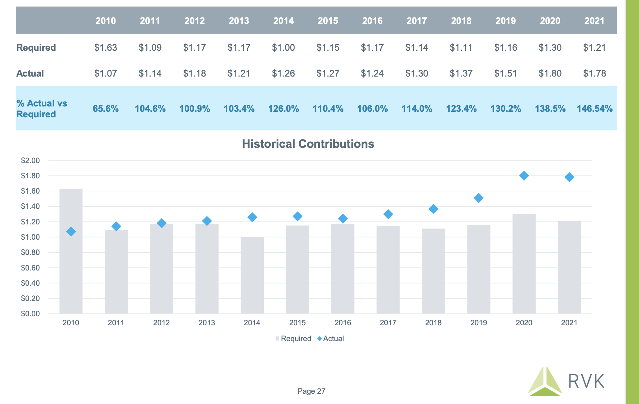

Slide 5
Dedicated Funding: “Off the Top”
Teachers:
4.5% of Income and Sales Taxes
5% of Lottery
Fire:
41% of Insurance Premium Tax
Police:
41% of Insurance Premium Tax
Law Enforcement:
6% of Insurance Premium Tax

Slide 6
2011: Oklahoma Pension Legislation Actuarial Analysis Act (OPLAA)
Requires Actuarial Report
Added Benefits Must Be Funded

Slide 7

Oklahoma Pensions Funding Status Improves
2004:
  59% Actuarial Value
  61% Market Value
  49th Worst Funded Pension
2021:
  81% Actuarial Value
  92% Market Value
  6th Best Funded Pension

Slide 8
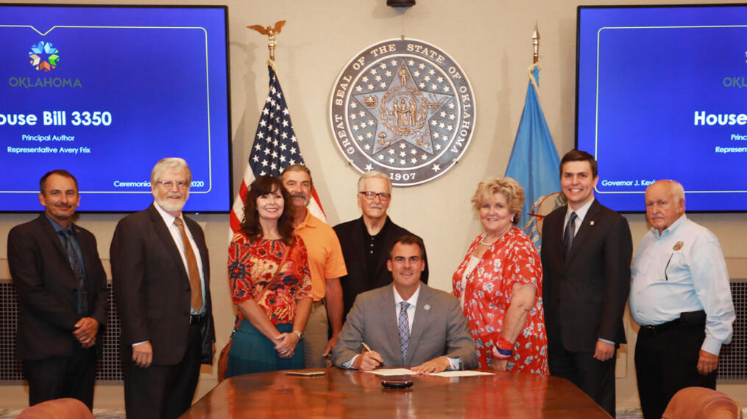
2020:
HB 3350
Important to Balance the Needs of Retirees
Cost of Living Adjustment for Retirees
0-2 Years Retired: 0
2-5 Years Retired: 2%
5 Years or More: 4%
First COLA in 12 Years
Paid for from System Assets

Slide 9

“There was a time when we were on that downward trend, and thanks to some of the legislative changes we’ve done—some of the sacrifices through no COLAs and things like that—we are on that positive trend and it would take quite a bit to bump us off that at this point.” – Chase Rankin, Director of OK Firefighters Pension System
“It’s kind of like saying, ‘Are you going to get hurt less if you stab me once or stab me twice?’ – Tom Spencer, Director of OK Teacher Retirement System
“If COLAs are not funded by the Legislature, and the plans are required to fund them, the plan is basically taking out a mortgage to pay for them,” said Joe Fox, Executive Director of the Oklahoma Public Employees Retirement System (OPERS). “They’re not free. They are costly.

Slide 10

Retirees Should be at the Center of the Retirement System
Health Insurance Costs have increased significantly
Inflation

Slide 11
Retirees Economic Impact
93% Stay in Oklahoma when they retire
Support the Local Economy

Slide 12
2015: Oklahoma Public Employees Retirement System moves to Defined Contribution for New Employees
Exempts County and Local Government Employees

Slide 13
DC System Observations
9 of 10 State Employees enrolled in the DC System Not Withdrawing or Not Rolling Over Retirement Account When Exiting State Employment, per Director Fox
Portability has made it easier to Leave Employment with the State, leading to Workforce Challenges
Liabilities are no longer into perpetuity
Employees: Higher Fees and Not Engaged in Investments, despite Education
Many look to move to another position within State Government that offers a DB Retirement Plan

Slide 14

More than three-quarters of new hires of employers sponsoring defined-benefit plans say the plans give them a compelling reason to stay on the job.

Slide 15

COLA Observations
Minimal Impact on System Assets
Not added back to Actuarial Assumptions
Not practical to use cash; Dedicated revenue exceeds required contribution

Slide 16

HB 2486
Closes the DC Plan
Allows Employees to buy service credit at Actuarial Value into the DB Plan

Slide 17

Benefits of HB 2486
Retain Workforce
Reduce Training Costs
Allow the System to continue into perpetuity
Provides Retirement Security for Retirees; Less Reliance on Government

