Slide 1
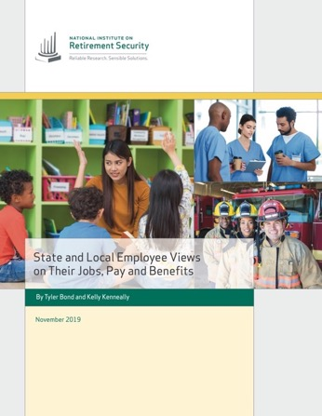
NEW Research
State and Local Employees Views on Their Jobs, Pay and Benefits
Webinar
November 18, 2019
2:00 PM ET

Slide 2

Agenda
Introductions
Research Review
Fact Sheets
Q&A
2

Slide 3

Webinar Logistics
Attendees in listen only mode.
Questions welcome. Type question using “Question” function on control panel, and we will answer.
Audio, technical issues during webinar, call GoToWebinar at 1-800-263-6317.
Webinar replay will be available.
3

Slide 4


Speakers
Dan Doonan NIRS Executive Director
Tyler Bond NIRS Research Manager and Report Co-Author
4

Slide 5
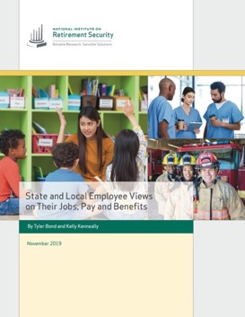
Why This Research?
State and local governments face challenges recruiting and retaining employees to deliver vital taxpayer services.
Policymakers best positioned to meet growing workforce demands when they fully understand what drives employee job decision making.
Develop deep understanding of how public employees view their jobs, benefits, as well as impacts of any cuts to benefits.
Assess differing views by profession and younger workers.
5

Slide 6

Methodology
Conducted by Greenwald & Associates, information for this study was collected from online interviews between August 22 - September 12, 2019.
A total of 1,118 public sector employees aged 18 and older completed the survey, including 362 teachers, 284 law enforcement personnel, 204 firefighters and 268 other public sector employees. All employees surveyed were required to be currently participating in a pension plan at their job.
The final data were weighted by age, gender, and personal income to reflect the demographics within each of these professions according to the Census Bureau’s 2018 Annual Social and Economic Supplement to the Current Population Survey. The results were also weighted to reflect the distribution of these professions within the public sector workforce.
6

Slide 7
9 Key Findings
State and local employees place a high value on serving the public and their community, and are generally satisfied with their job despite high stress.
Benefits are among the most important job features for state and local employees.
State and local employees have mixed views on the competitiveness of their salary. They are in agreement that their benefits are competitive -- but without a pension, their compensation is less competitive.
Benefits are viewed as a powerful recruitment and retention tool across state and local government professions.
7

Slide 8
Key Findings (continued)
State and local government employees overwhelmingly have favorable views of pensions, with lasting retirement income and monthly checks the most important features.
Most public workers feel they will be financially secure in retirement, but the vast majority of state and local employees are highly concerned about cuts to retirement benefits & government officials underfunding of pension plans.
Cutting state and local employee benefits could drive them out of the public workforce.
State and local employees say eliminating pensions for state and local workers has risks.
Millennials working in state and local generally share the views of Baby Boomers and GenXers on their job, serving the public, pay, and benefits.
8

Slide 9
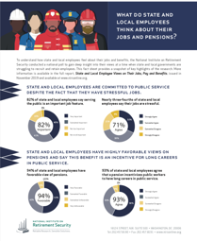
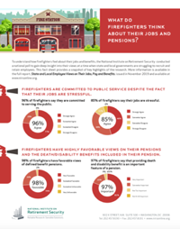
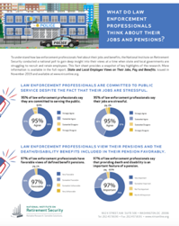
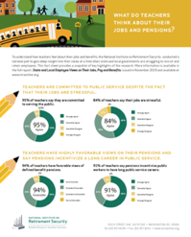
Four Fact Sheets
9

Slide 10

1 Key Finding
State and local employees place a high value on serving the public and their community, and are generally satisfied with their job despite high stress.
10

Slide 11
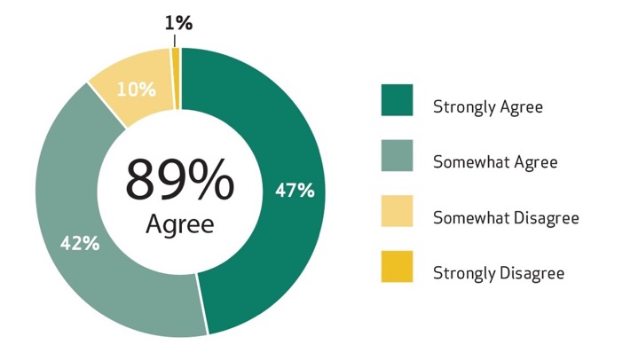
The majority of public employees satisfied with ability to serve the public.
11

Slide 12
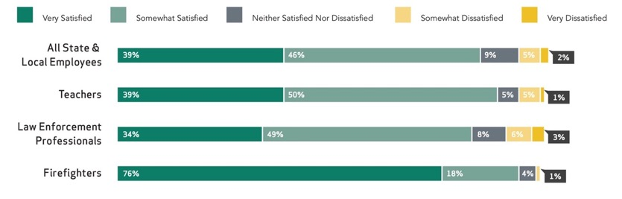
85% of public employees satisfied with their job.
12

Slide 13
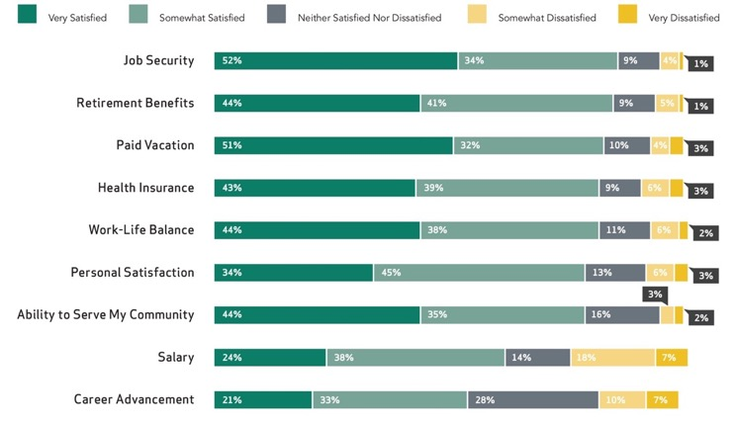
State and local employees more satisfied with benefits than salary.
13

Slide 14
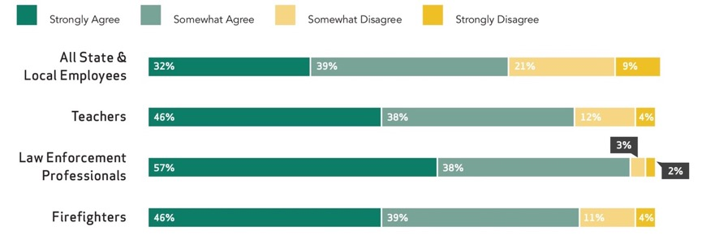
Nearly three-fourths of state and local employees say their jobs are stressful.
14

Slide 15

2 Key Finding
Benefits are among the most important job features for state and local employees.
15

Slide 16
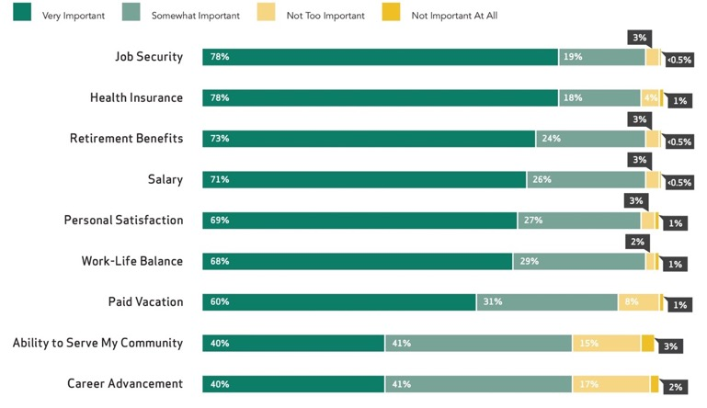
Benefits are more important job feature than salary for state and local employees.
16

Slide 17
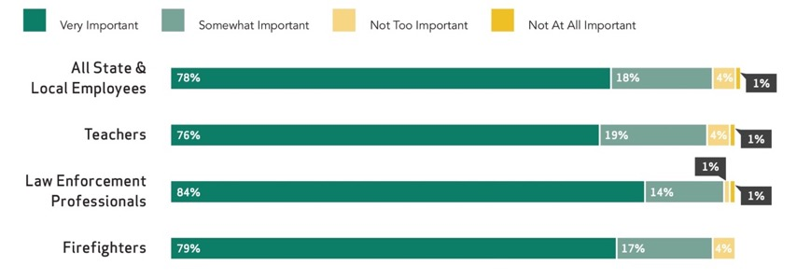
Across professions, healthcare is highly important job feature.
17

Slide 18
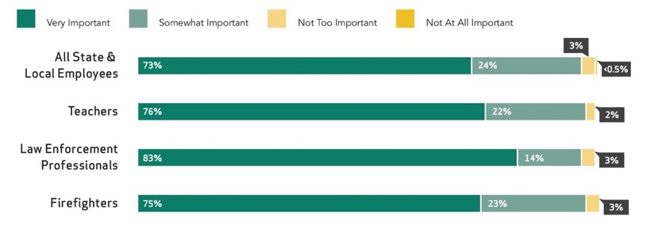
Across profession, retirement benefits are highly important job feature.
18

Slide 19

3 Key Finding
State and local employees have mixed views on the competitiveness of their salary. They are in agreement that their benefits are competitive -- but without a pension, their compensation is less competitive.
19

Slide 20
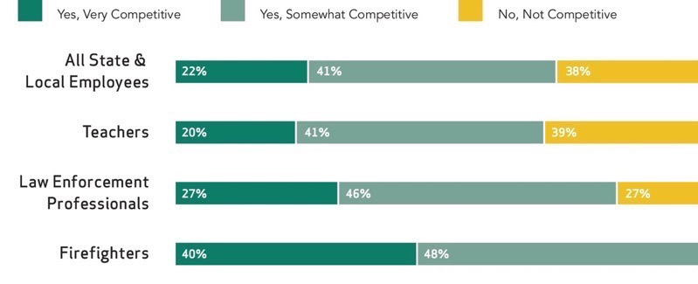
State and local employees have mixed views on the competitiveness of their salary.
20

Slide 21
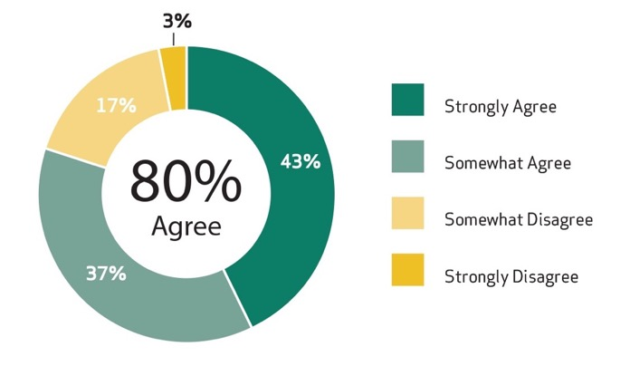
But, they agree they could earn a higher salary in the private sector.
21

Slide 22
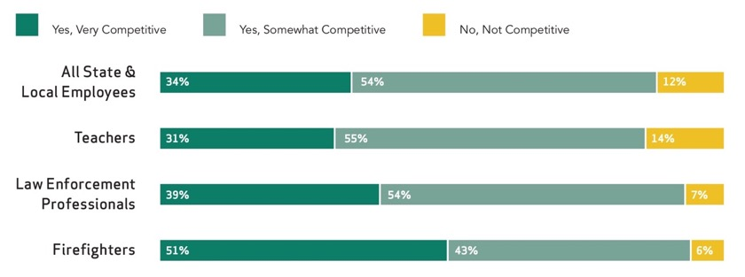
The vast majority (88%) agree that their retirement benefits are competitive.
22

Slide 23
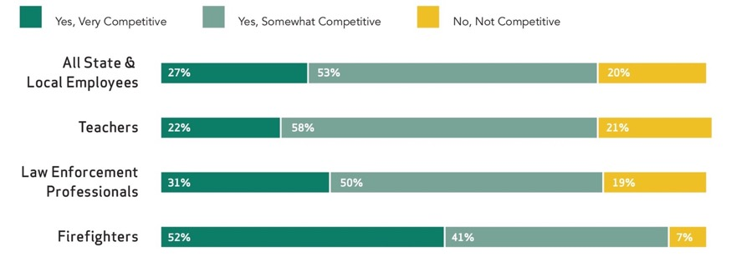
And the vast majority (80%) agree that their total compensation is competitive.
23

Slide 24
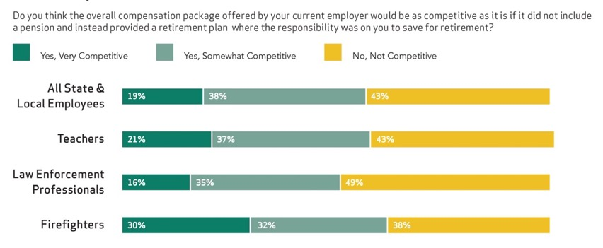
But they views their total compensation as less competitive when it lacks a pension.
24

Slide 25

4 Key Finding
Benefits are viewed as a powerful recruitment and retention tool across state and local government professions.
25

Slide 26
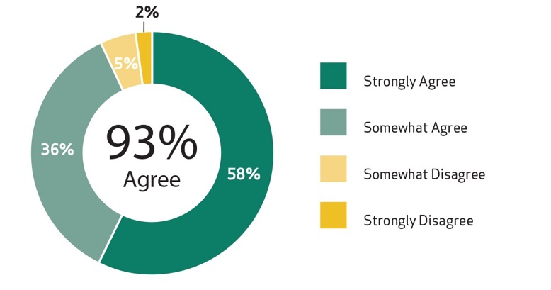
Nearly all (93%) say pensions are an incentive for long public service careers.
26

Slide 27
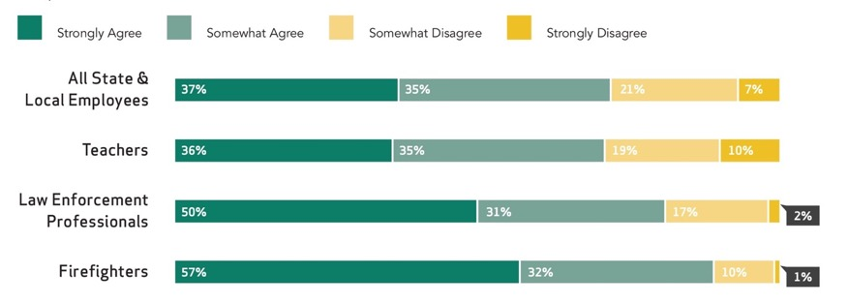
72% say a pension is a major reason state and local workers chose a career in public service.
27

Slide 28
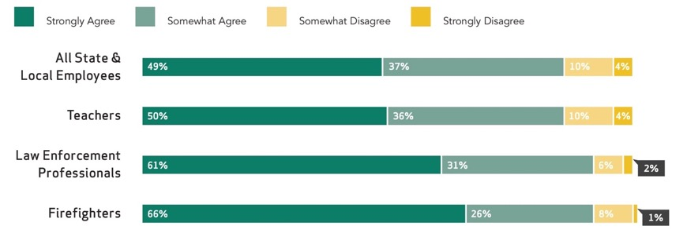
86% say a pension is a major reason state and local workers stay public service.
28

Slide 29
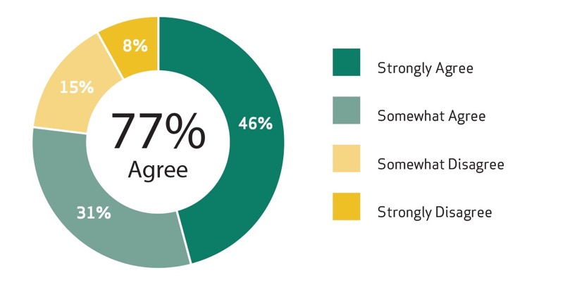
State and local workers also agree healthcare benefits also important reason for selecting public sector job.
29

Slide 30
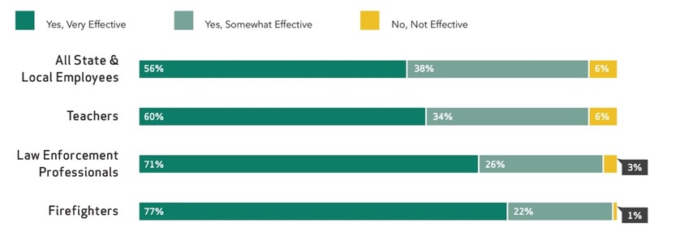
94% of state and local workers agree pensions effective for attracting new employees to public jobs.
30

Slide 31
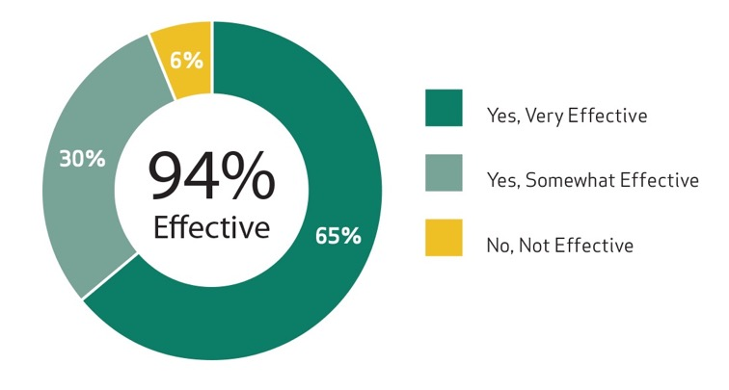
94% of state and local workers agree pensions effective for retaining employees.
31

Slide 32
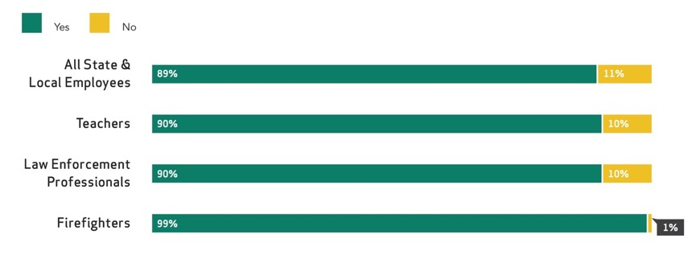
89% plan to stay in jobs until retirement or unable to work.
32

Slide 33

5 Key Finding
State and local government employees overwhelmingly have favorable views of pensions, with lasting retirement income and monthly checks the most important features.
33

Slide 34
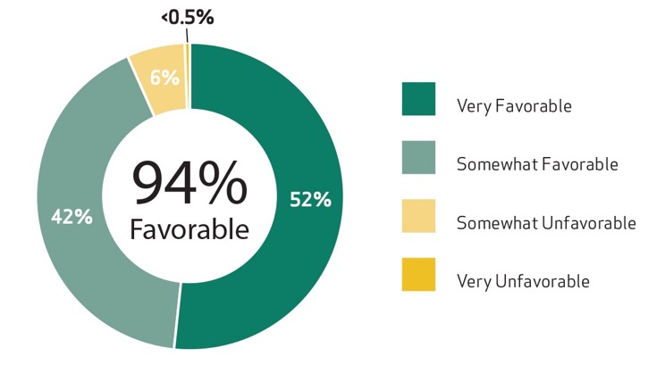
94% plan have favorable views of pensions.
34

Slide 35
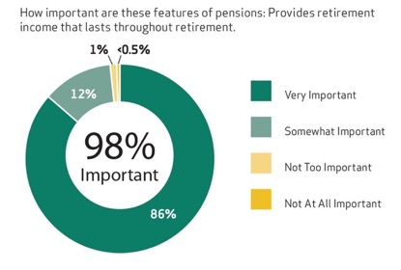
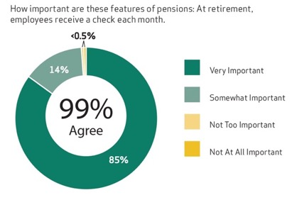
Lasting income and a monthly check are important features of pensions to state and local workforce.
35

Slide 36

6 Key Finding
Most state and local employees feel they will be financially secure in retirement, but the vast majority of are highly concerned about cuts to retirement benefits & government officials underfunding of pension plans.
36

Slide 37
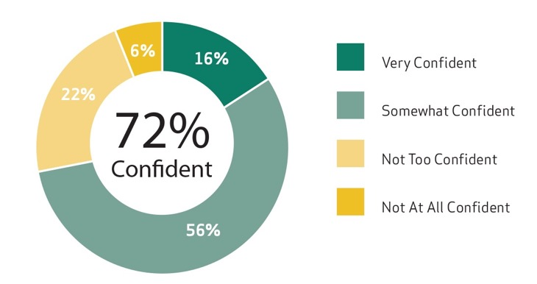
Nearly three-fourths of state and local workers are confident they will be financially secure in retirement.
37

Slide 38
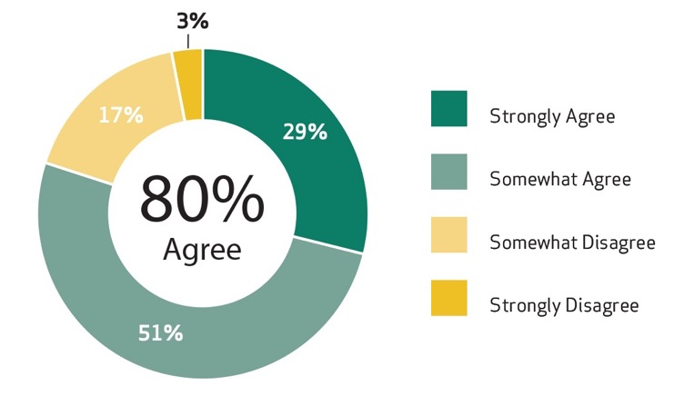
State and local workforce agrees pensions better than 401(k)-style individual accounts for maintaining standard of living in retirement.
38

Slide 39
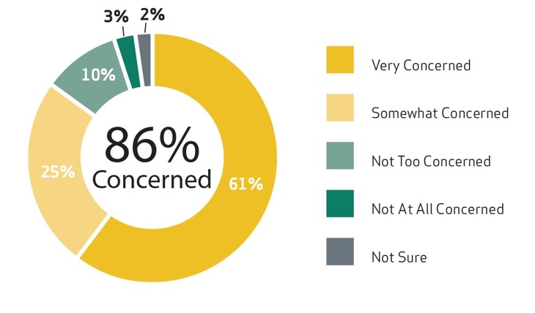
But most are concerned about cuts to their pensions.
39

Slide 40
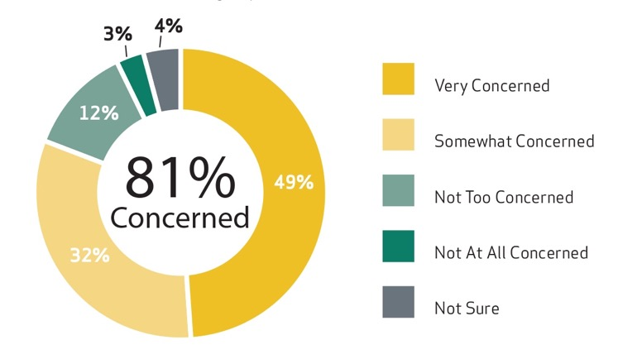
And they also are worried about COLA cuts.
40

Slide 41
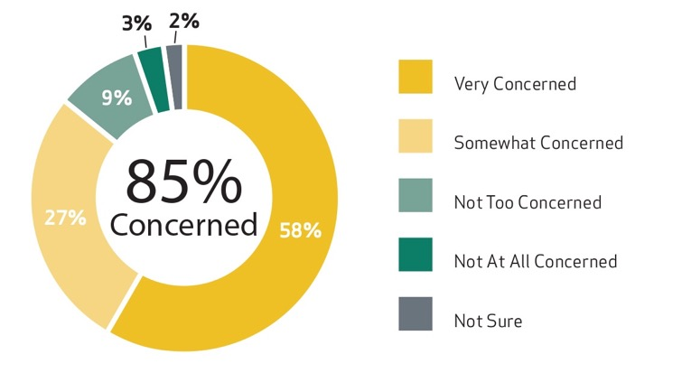
And underfunding of pensions by government officials is a concern for state and local employees.
41

Slide 42

7 Key Finding
State and local employees say cutting employee benefits could drive them out of the public workforce.
42

Slide 43
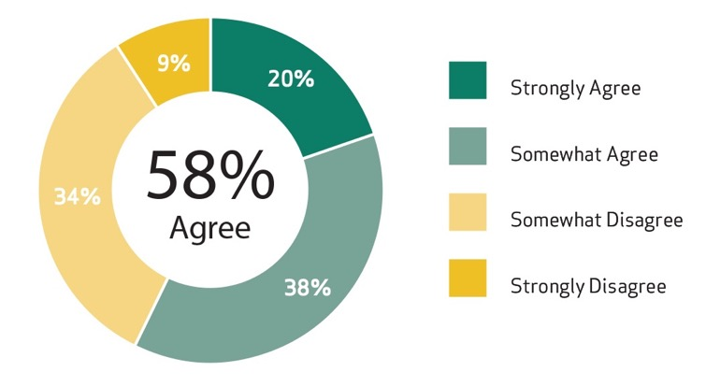
More than half of state and local employees say switching out of pensions would make them more likely to leave their job.
43

Slide 44
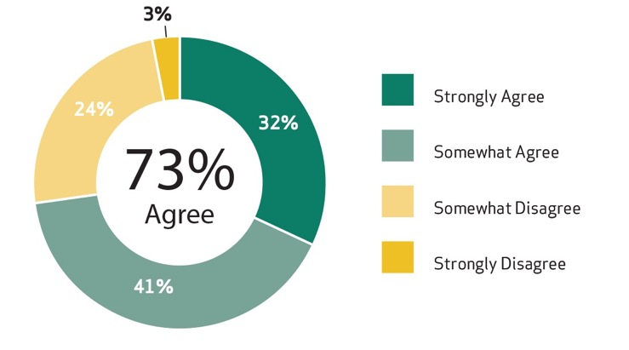
Nearly three-fourths of state and local workers say they’re more likely to their leave job if pension cut.
44

Slide 45
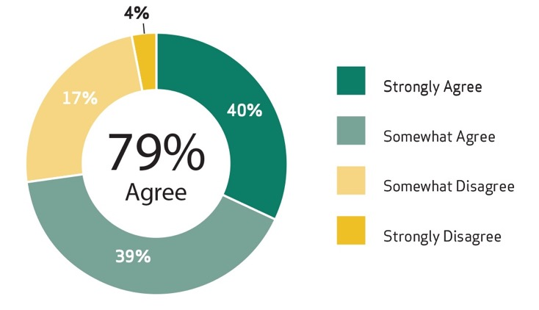
More than three-fourths of state and local workers say they’re more likely to their leave job if healthcare cut.
45

Slide 46

8 Key Finding
State and local employees say eliminating pensions has risks.
46

Slide 47
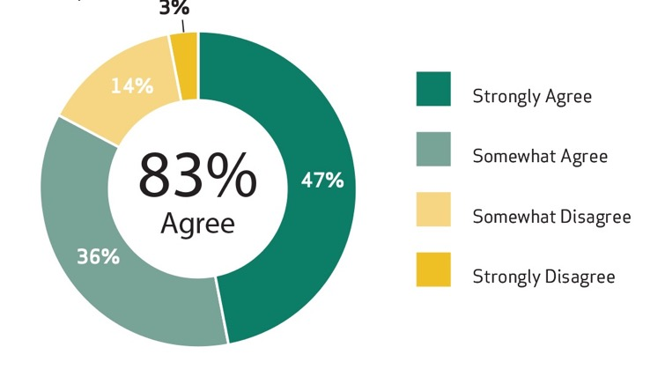
Most state and local workers say eliminating pensions would weaken public safety.
47

Slide 48
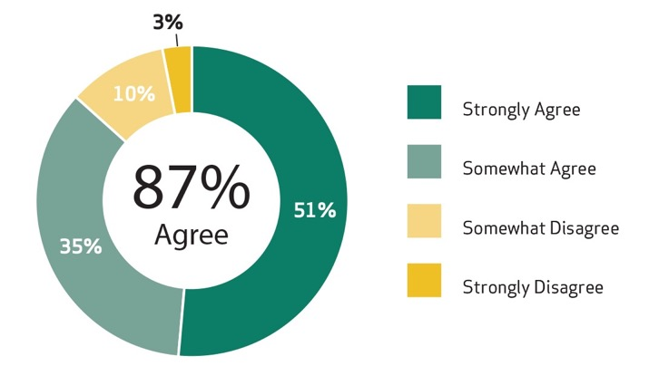
Most state and local workers say eliminating pensions would weaken education system.
48

Slide 49
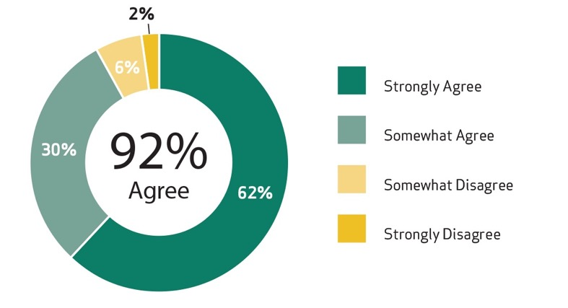
Nearly all state and local workers say eliminating pensions would harm recruitment and retention.
49

Slide 50

9 Key Finding
Millennials working in state and local government generally share the views of Baby Boomers and GenXers on their job, serving the public, pay, and benefits.
50

Slide 51
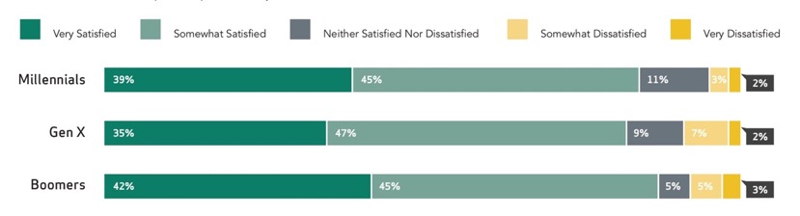
84% of Millennials working in state and local government are satisfied with their job.
51

Slide 52
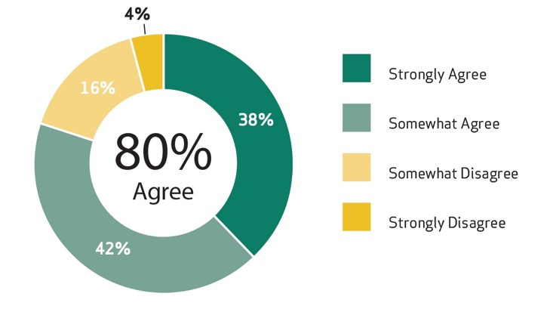
80% of Millennials working in state and local government say they could earn a higher salary in the private sector.
52

Slide 53
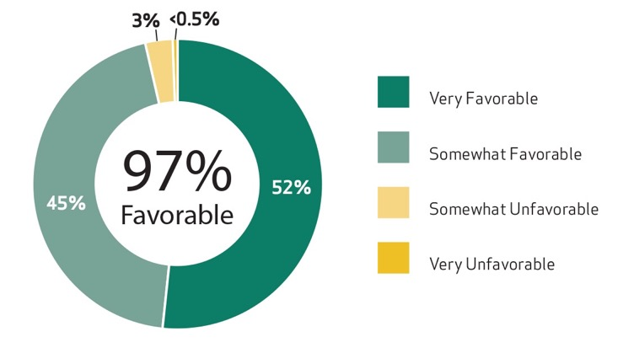
Nearly all Millennials working in state and local government have favorable views of pensions.
53

Slide 54
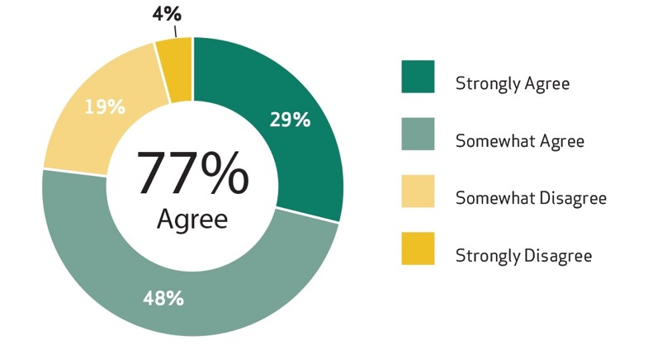
More than three-fourths of Millennials agree a pension is better than a 401(k) for maintaining their standard of living in retirement.
54

Slide 55
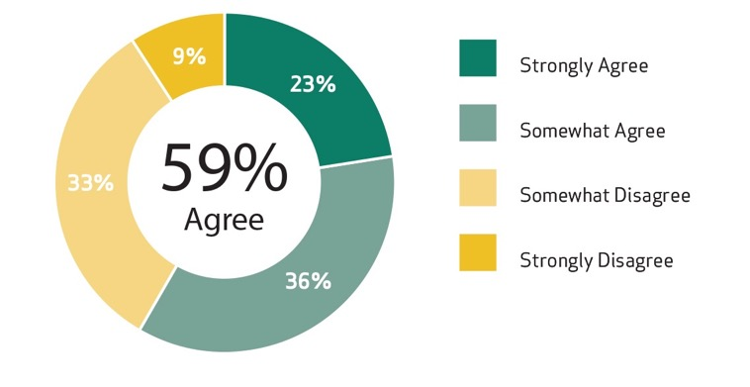
More than half of Millennials in state and local government agree switching out of pension would make them more likely to leave their job.
55

Slide 56
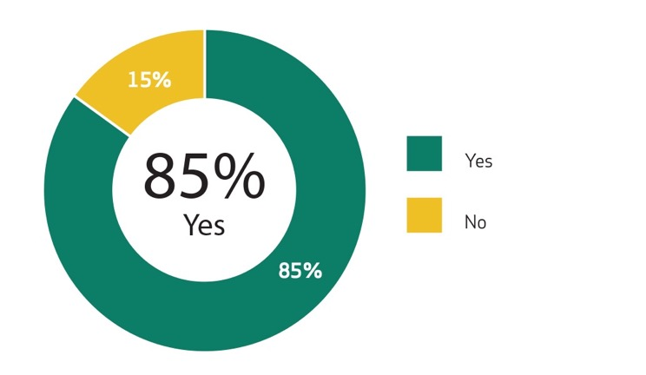
Most Millennials in state and local government say they plan plan to stay with employer until retirement or until can’t work.
56

Slide 57
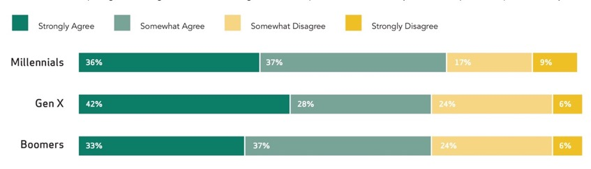
Three-fourths of Millennials in state and local government agree a pension is a major reason they chose a public sector job.
57

Slide 58
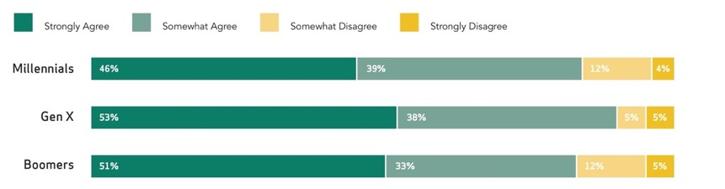
Most Millennials in state and local government agree a pension is a major reason they stay in their job.
58

Slide 59

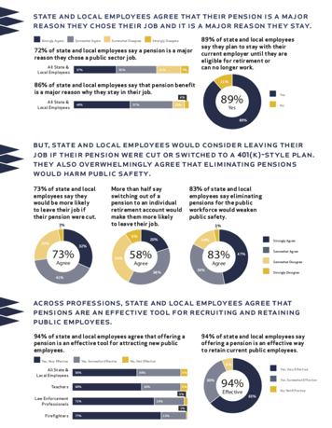
State & Local Employees Fact Sheet
59

Slide 60

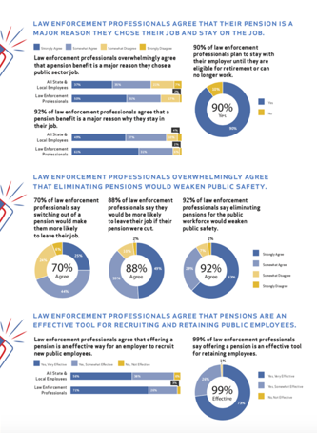
Law Enforcement Fact Sheets
60

Slide 61
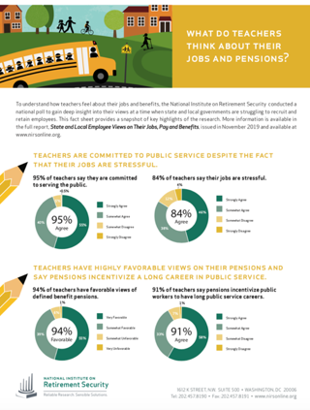


Teacher Fact Sheets
61

Slide 62


Firefighter Fact Sheets
62

