Slide 1
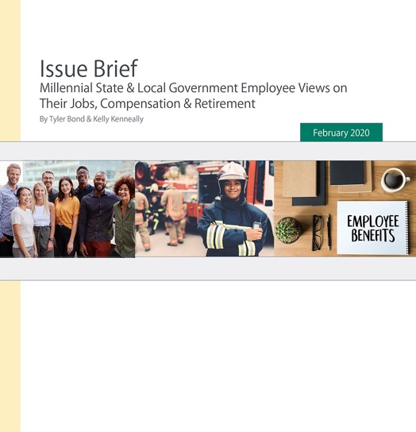
NEW Research
Millennial State & Local Government Employee Views on Their Jobs, Compensation & Retirement
February 2020

Slide 2
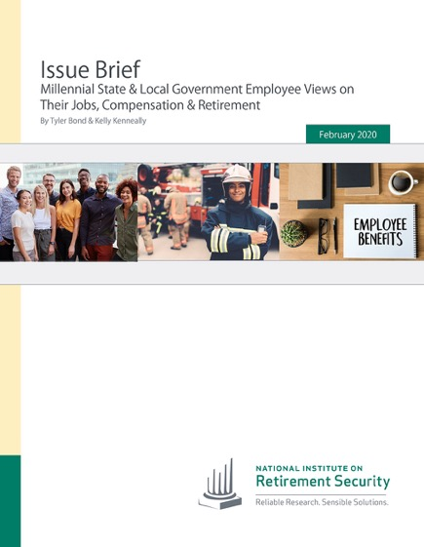
Why This Research?
State and local governments face challenges recruiting and retaining employees to deliver vital taxpayer services.
Millennials are a growing share of public workforce. In 2019, 32% of state and local employees were Millennials.
Policymakers best positioned to meet growing workforce demands when they fully understand what drives Millennial employee job decision making.
Debunks myths about the Millennial generation in the workforce.
2

Slide 3
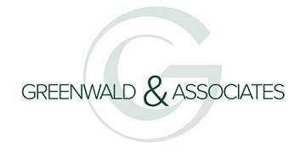
Methodology
Conducted by Greenwald & Associates, information for this study was collected from online interviews between August 22 - September 12, 2019.
A total of 1,118 public sector employees aged 18 and older completed the survey, including 492 Millennials. All employees surveyed were required to be currently participating in a pension plan at their job.
The final data were weighted by age, gender, and personal income to reflect the demographics according to the Census Bureau’s 2018 Annual Social and Economic Supplement to the Current Population Survey.
3

Slide 4
5 Key Findings
Despite knowing they could earn a higher salary in the private sector, Millennials working in state and local government are satisfied with their jobs and total compensation.
State & local government Millennial employees are planning to stick with their current job but changing their benefits might push some out the door.
Millennials working in state and local government are highly supportive of pensions, and they see the advantages of their benefits beyond retirement.
State and local government Millennial employees feel confident about their retirement but worry about cuts or changes to benefits.
State and local government Millennial workers say eliminating pensions has negative consequences.
4

Slide 5

1 Key Finding
Despite knowing they could earn a higher salary in the private sector, Millennials working in state and local government are satisfied with their jobs and total compensation.
5

Slide 6
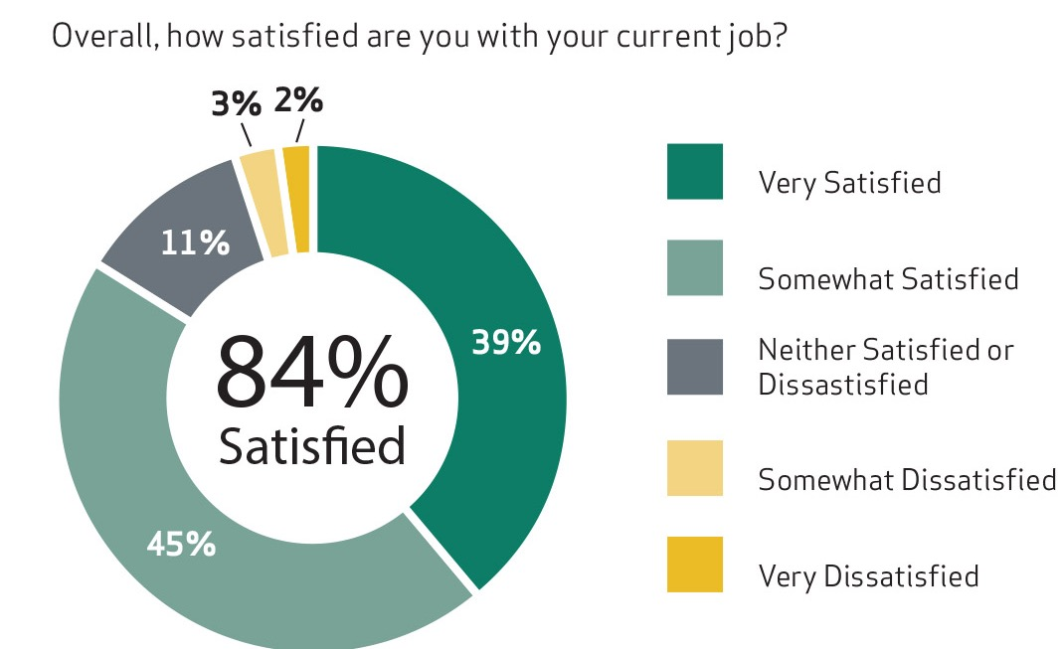
84% of Millennials working in state and local government are satisfied with their current job.
6

Slide 7
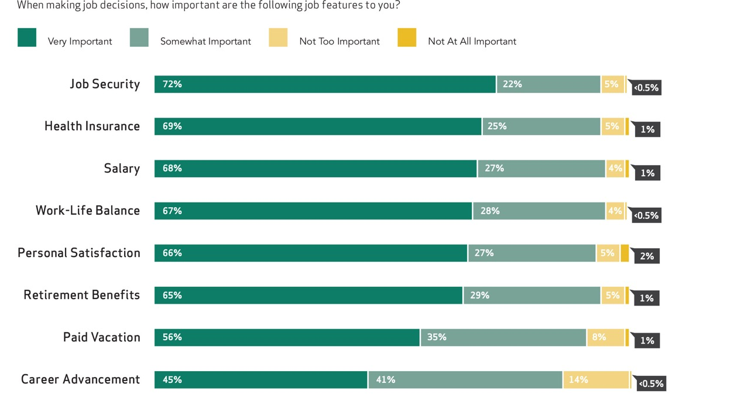
Job security, salary, benefits and work-life balance are very important job features for Millennials in state & local government.
7

Slide 8
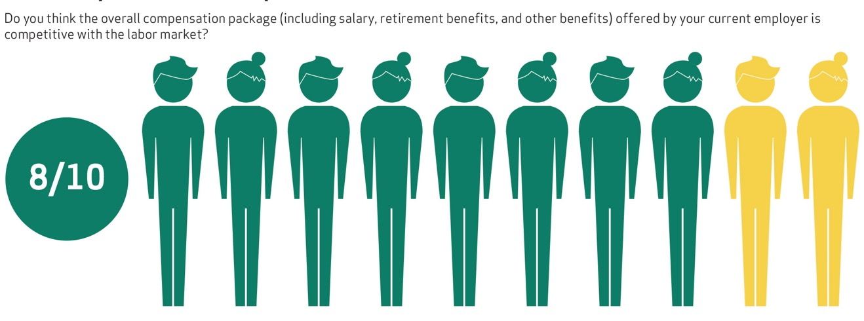
80% of Millennials working in state & local government say their total compensation is competitive.
8

Slide 9
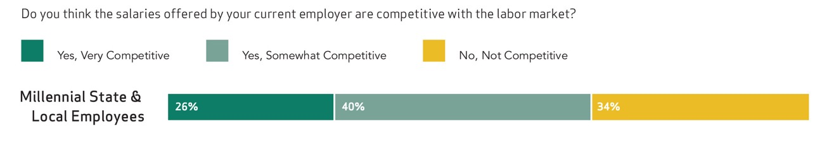
About one quarter of Millennials in state and local government view their salary as very competitive.
9

Slide 10
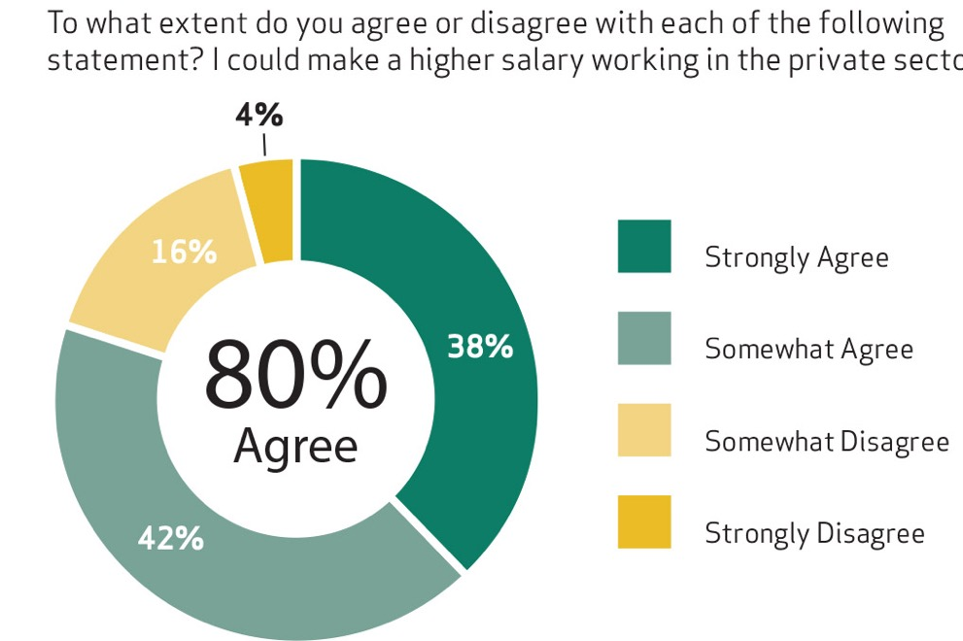
80% of Millennials in state & local government believe they could earn a higher salary in the private sector.
10

Slide 11
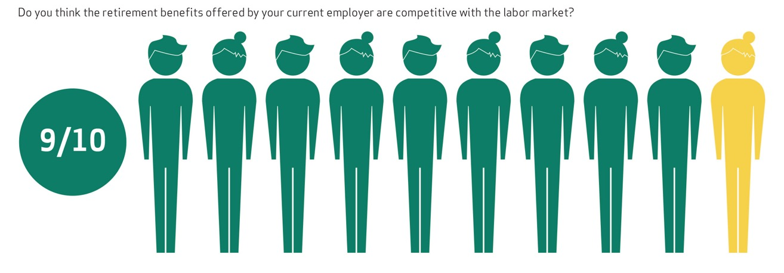
The vast majority of Millennials (90%) see their retirement benefits as competitive.
11

Slide 12
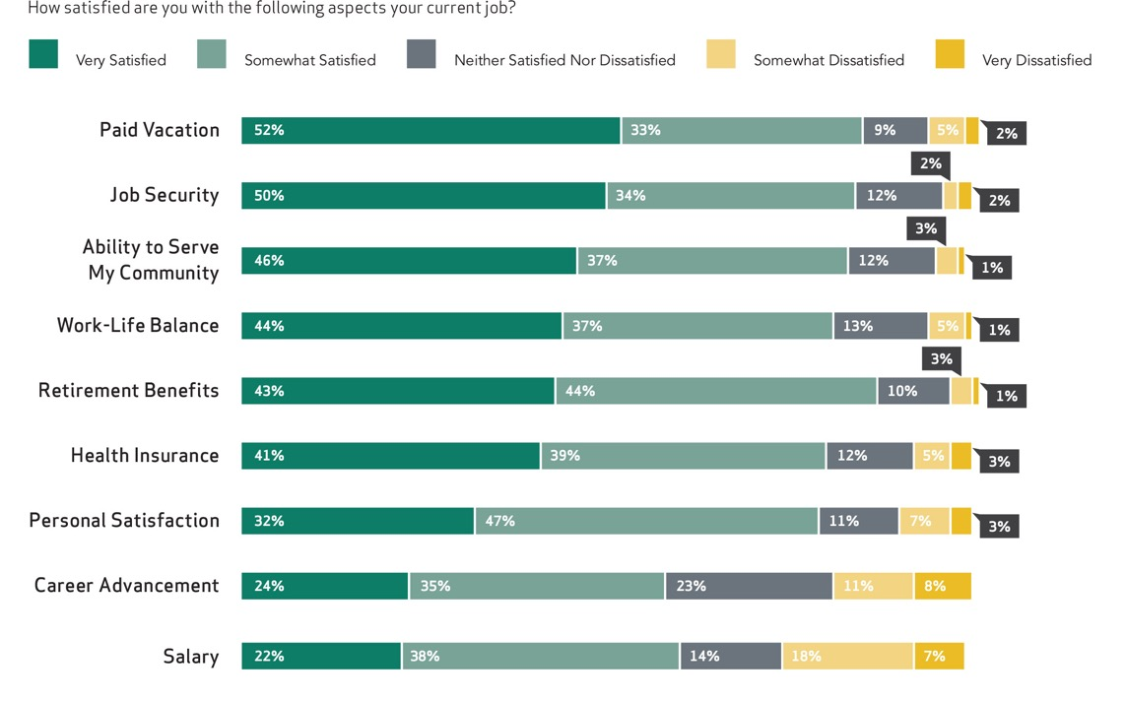
Millennials working in state & local government are satisfied with their job security and benefits, but less satisfied with their salary and career advancement.
12

Slide 13

2 Key Finding
State & local government Millennial employees are planning to stick with their current job, but changing their benefits might push some out the door.
13

Slide 14
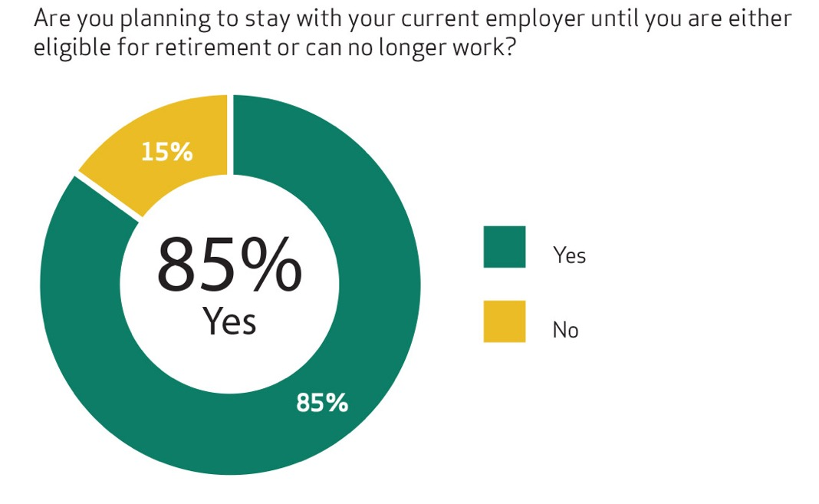
Most Millennials (85%) in state & local government plan to stay in their job until they retire or can’t work.
14

Slide 15
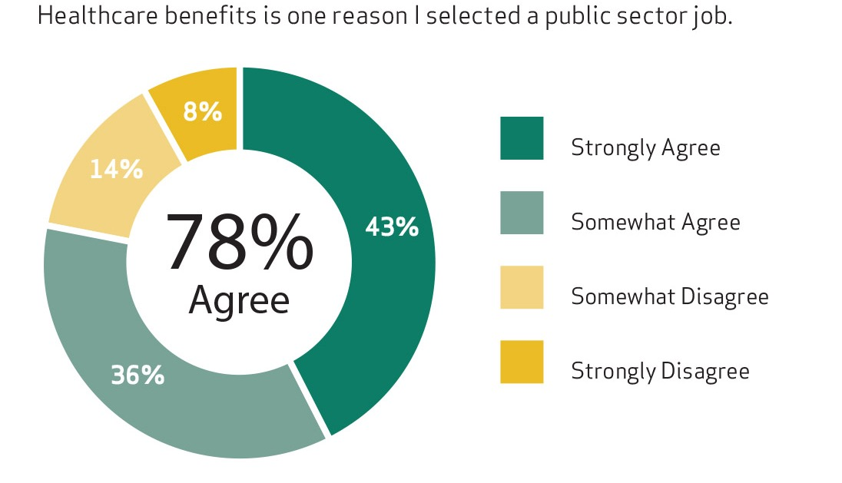
Healthcare benefits is a reason why 78% of Millennials chose to work in the public sector.
15

Slide 16
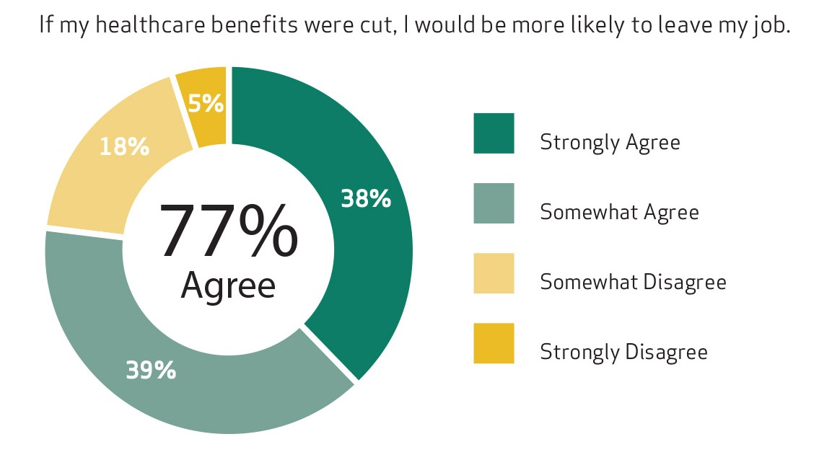
77% of Millennials working in state & local government say they would be more likely to leave their job if their healthcare benefits were cut.
16

Slide 17
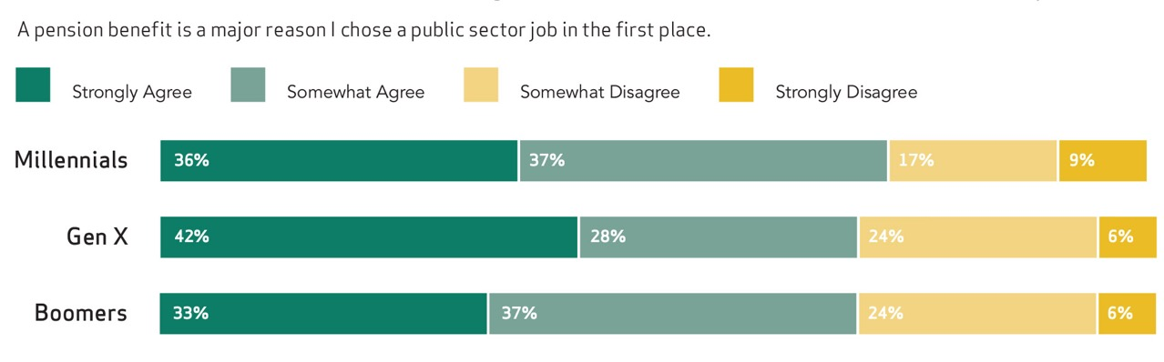
Similar to other generations, a pension is a reason that 74% of Millennials in state & local government selected a public sector job.
17

Slide 18
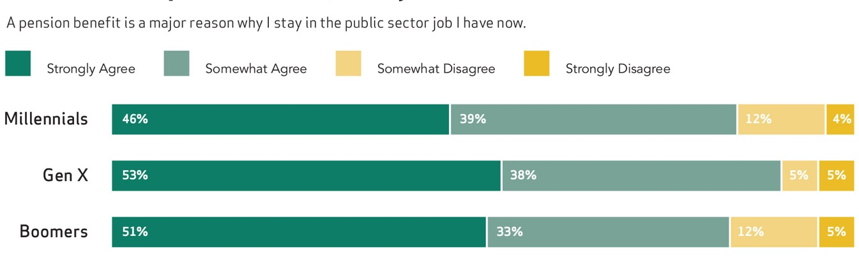
Similar to previous generations, a pension is a reason 84% of Millennials stay in their state/local job.
18

Slide 19
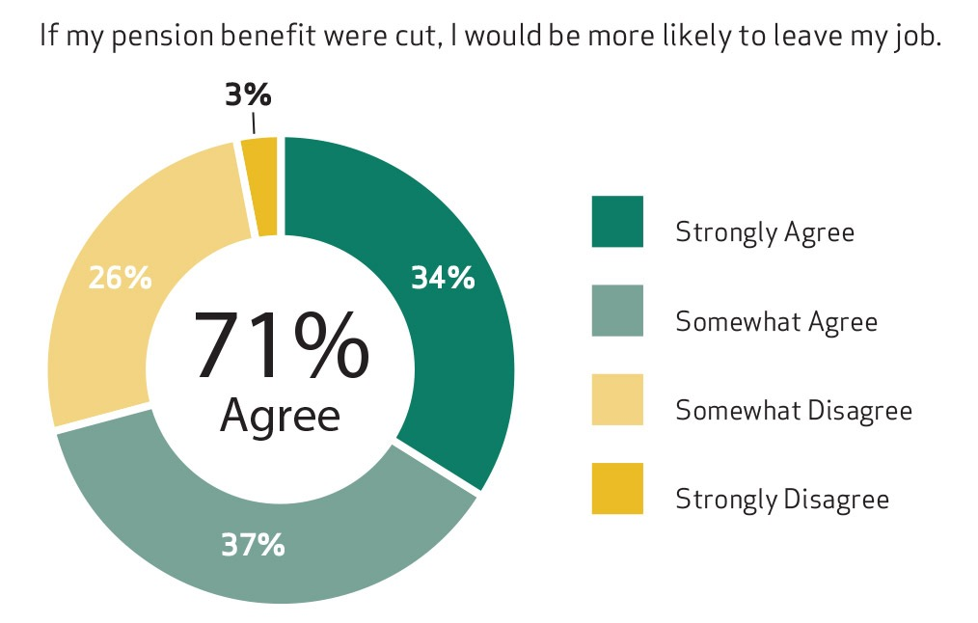
71% of Millennials say they would be more likely to leave their state/local job if their pension were cut.
19

Slide 20
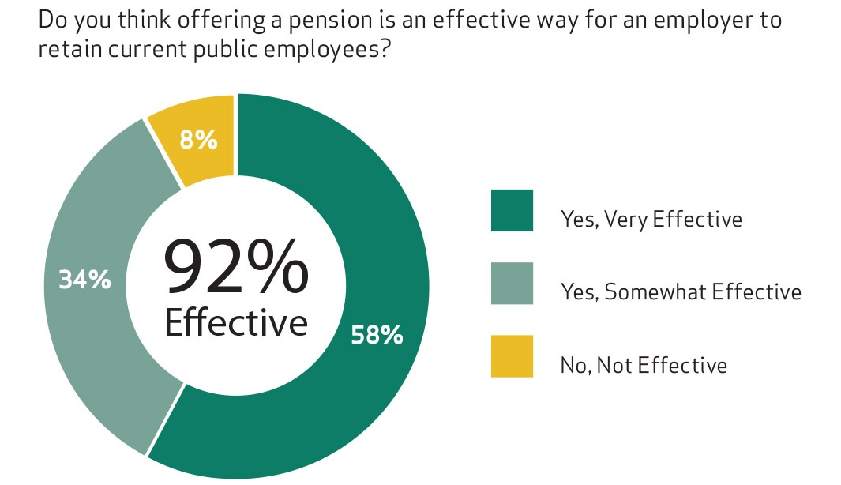
Pensions are an effective way to retain state & local employees according to 92% of Millennial state & local employees.
20

Slide 21
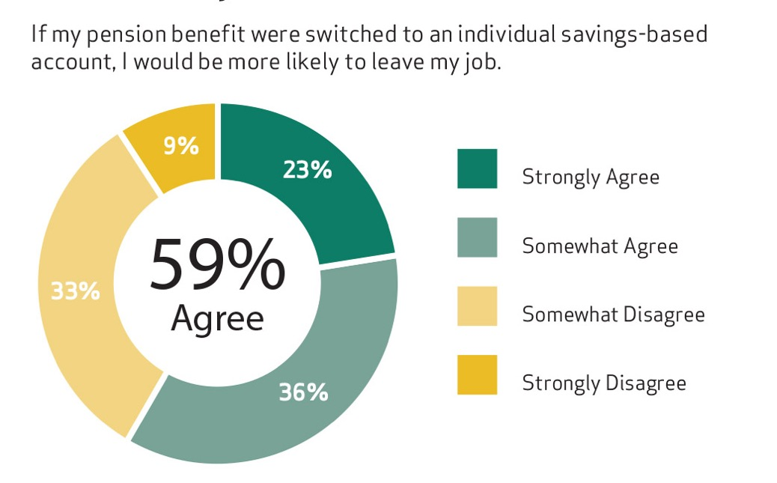
If a pension benefit were switched to an individual savings account, most Millennials (59%) in state & local government would be more likely to leave their job.
21

Slide 22

3 Key Finding
Millennials working in state and local government are highly supportive of pensions, and they see the advantages of their benefits beyond retirement.
22

Slide 23
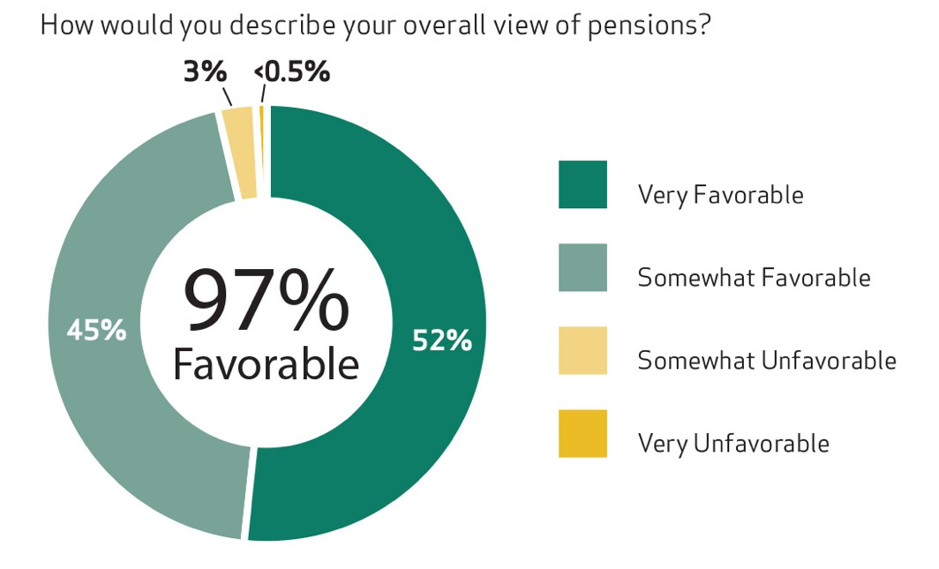
Nearly all Millennials (97%) working in state and local government have a favorable view of pensions.
23

Slide 24
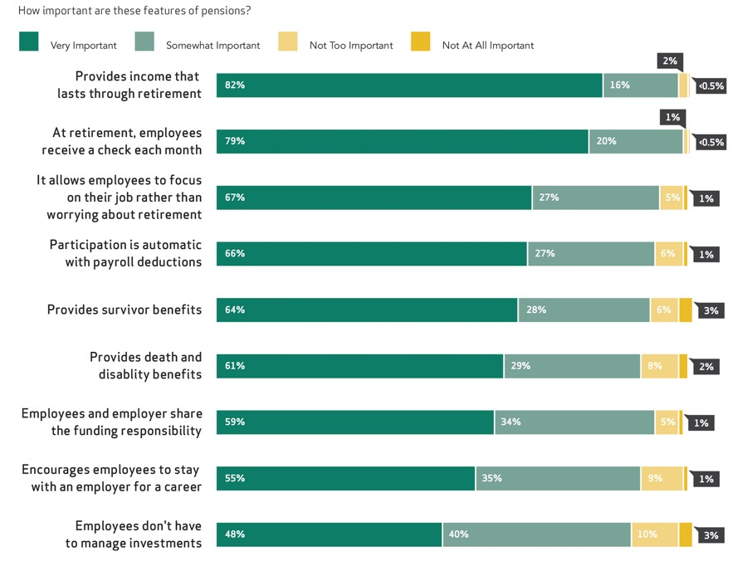
Lasting income, and a monthly check are the most important features of pensions for Millennials in state and local government.
24

Slide 25
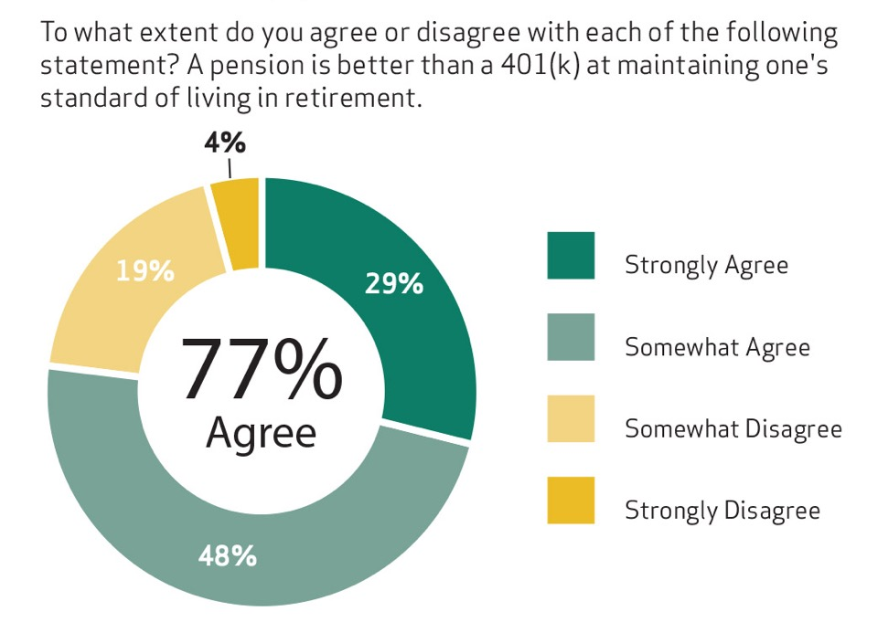
More than three-fourths of Millennials working in state and local government say that a pension is better than a 401(k).
25

Slide 26
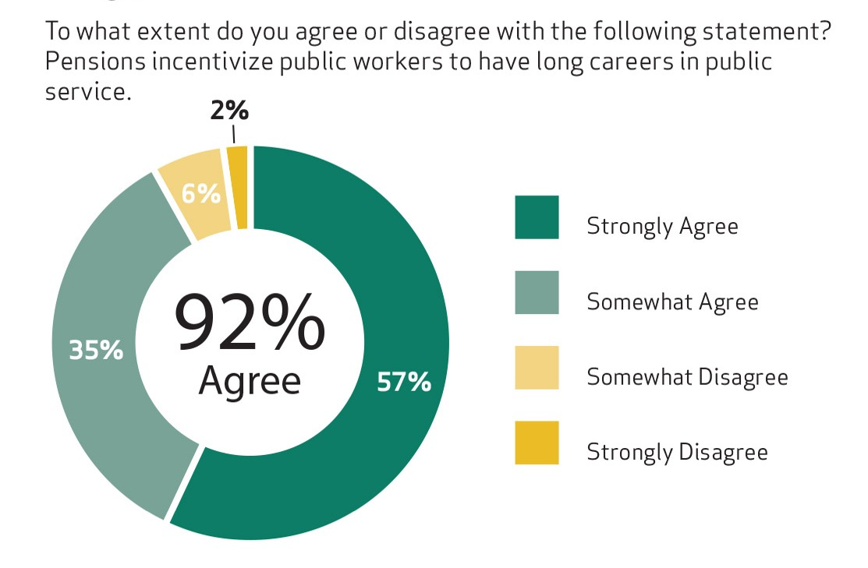
92% of state & local government Millennial employees say pensions incentivize a long public service career.
26

Slide 27
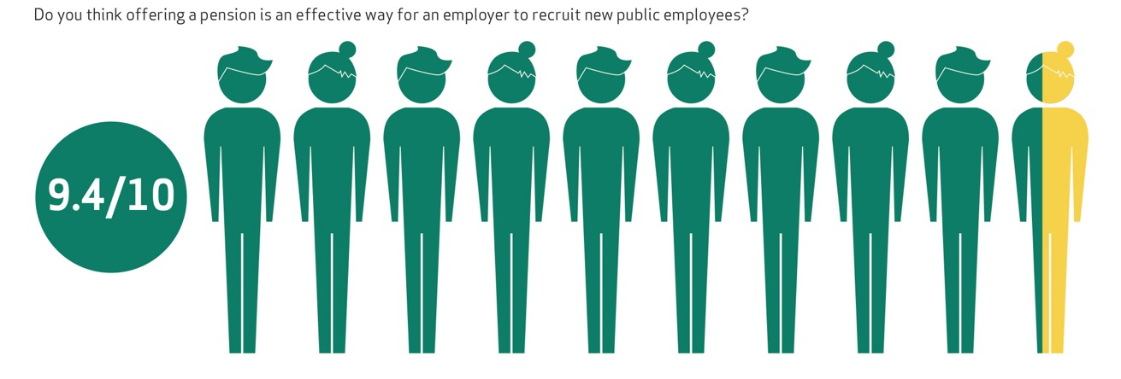
94% of Millennials working in state & local government say pension are good tool to recruit new employees.
27

Slide 28

4 Key Finding
State and local government Millennial employees feel confident about their retirement but worry about cuts or changes to benefits.
28

Slide 29
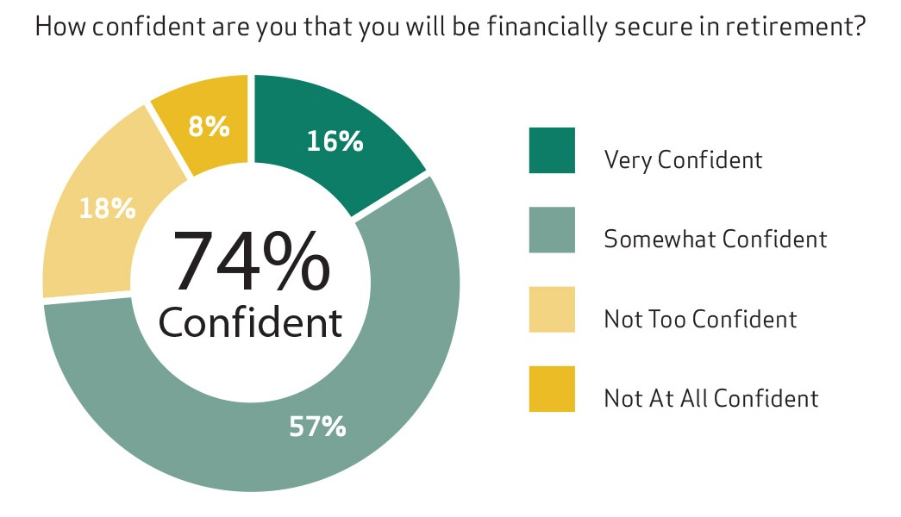
74% of Millennials working in state and local governments say they will be financially secure in retirement.
29

Slide 30
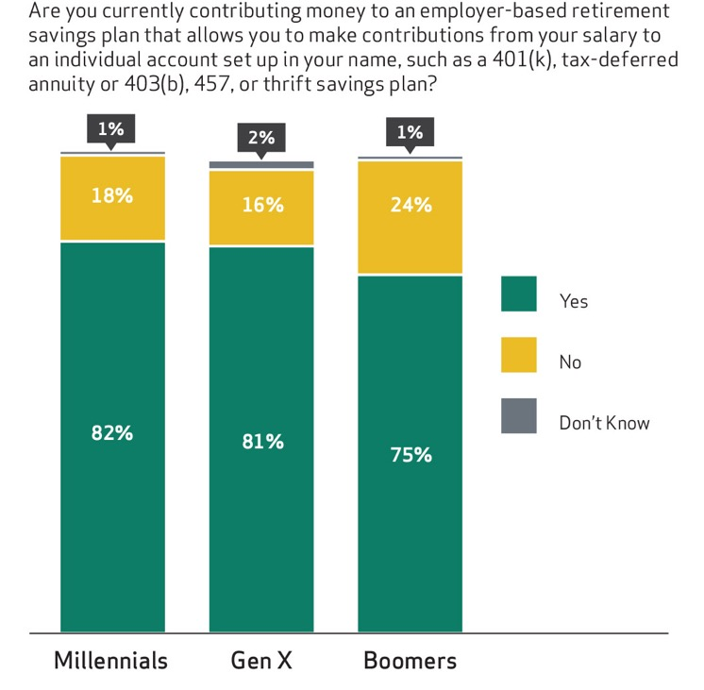
Millennials working in state & local government are contributing to supplemental savings at a higher rate than Baby Boomers.
30

Slide 31
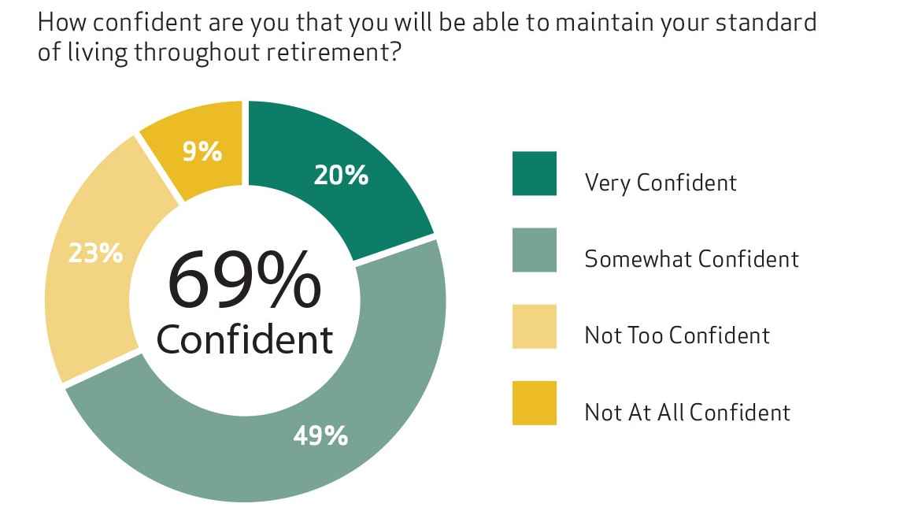
69% of Millennials working in state & local government are confident they will be able to maintain their standard of living throughout retirement.
31

Slide 32
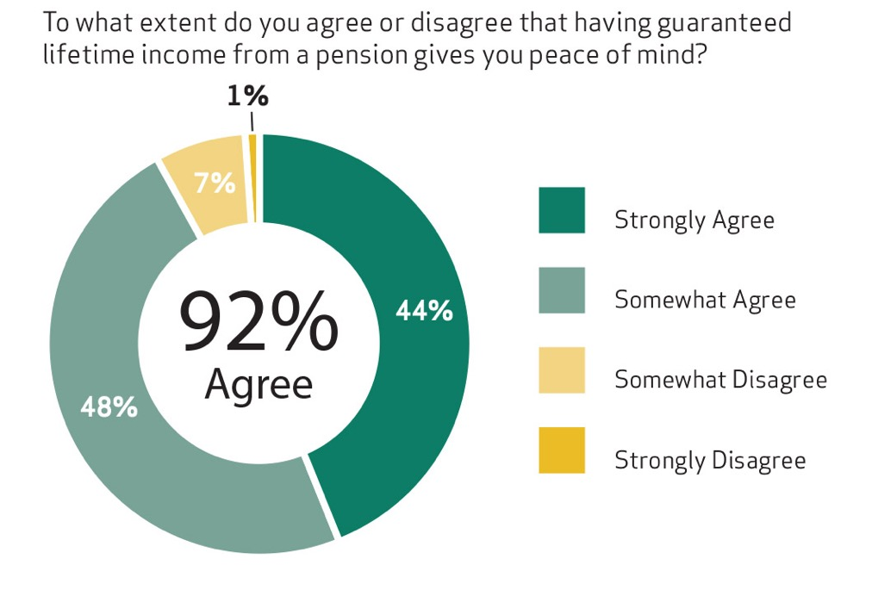
92% of state & local government Millennial employees agree that a pension with guaranteed lifetime income provides peace of mind in retirement.
32

Slide 33
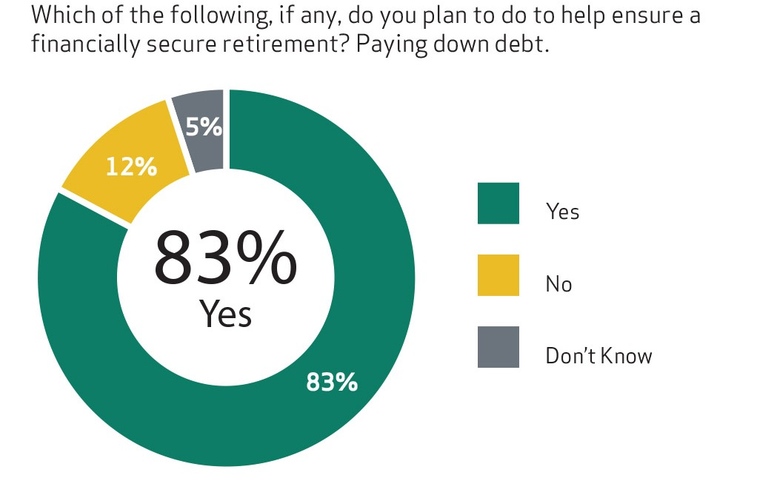
83% of Millennials working in state & local government plan to pay down debt to ensure financial security in retirement.
33

Slide 34
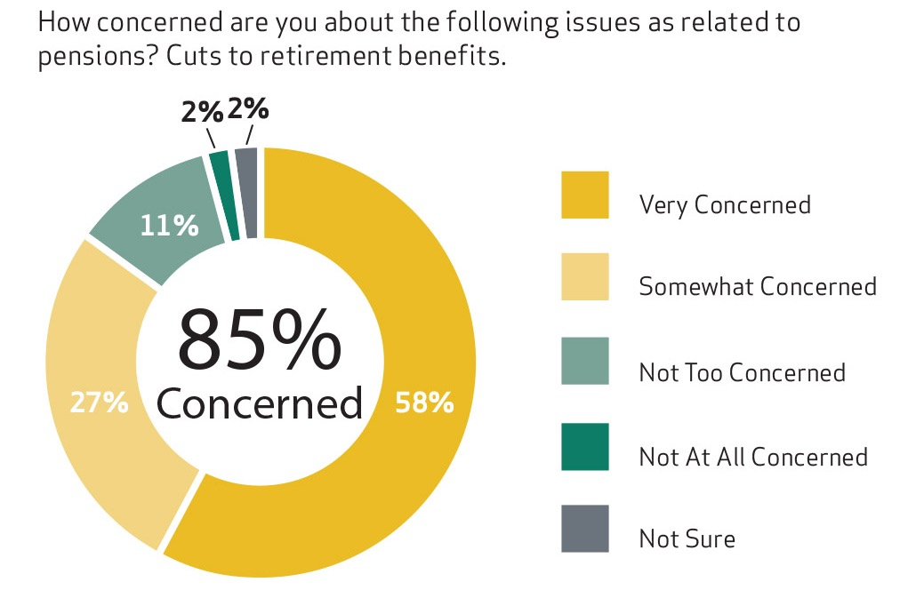
85% of Millennials working in state & local government are concerned about possible pension cuts.
34

Slide 35
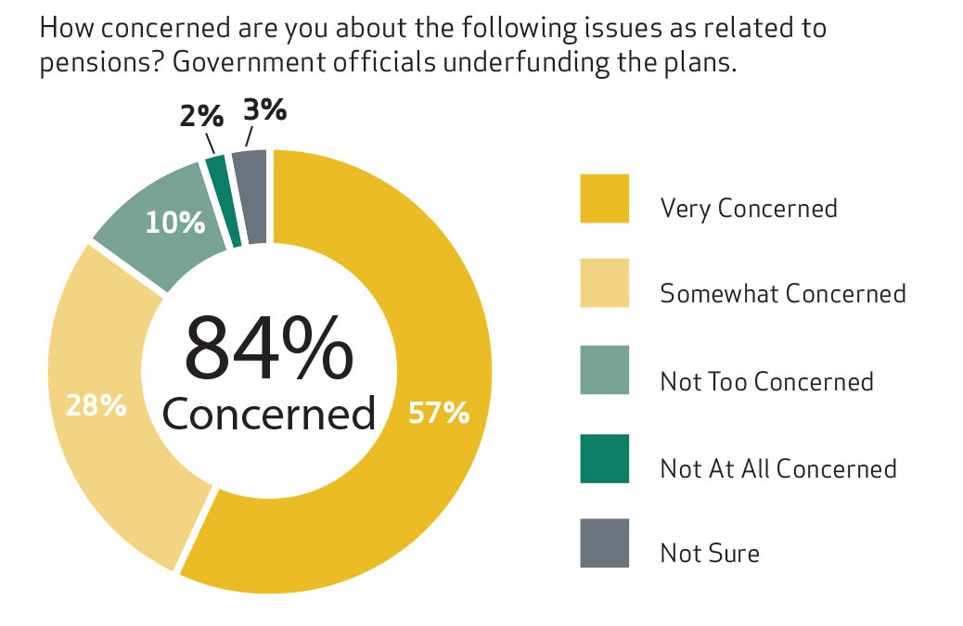
Most 84% of Millennials working in state & local government are concerned about government officials underfunding pension plans.
35

Slide 36
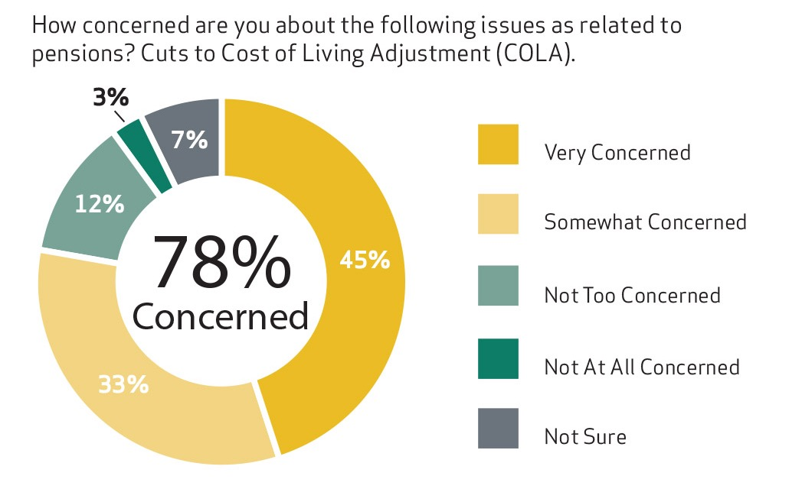
78% of Millennials working in state & local government are concerned about COLA cuts.
36

Slide 37

5 Key Finding
State and local government Millennial workers say eliminating pensions has negative consequences.
37

Slide 38
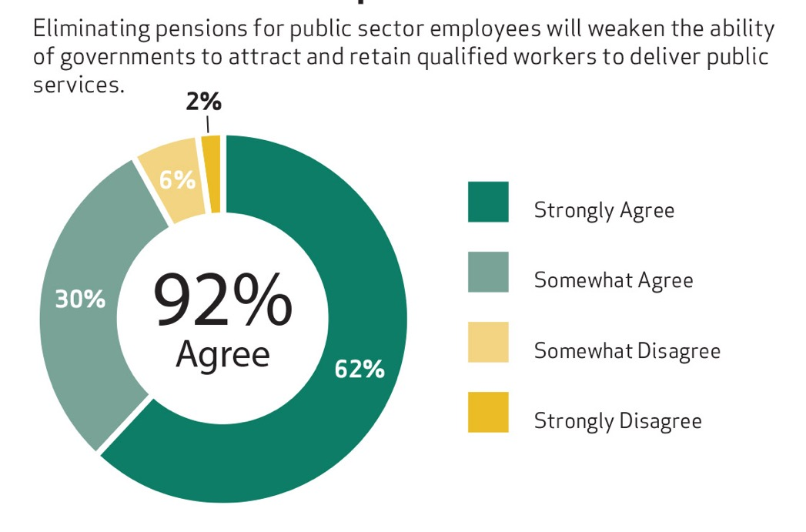
92% of Millennials in state & local government say eliminating pensions will weaken government’s ability to recruit & retain workers to deliver public services.
38

Slide 39
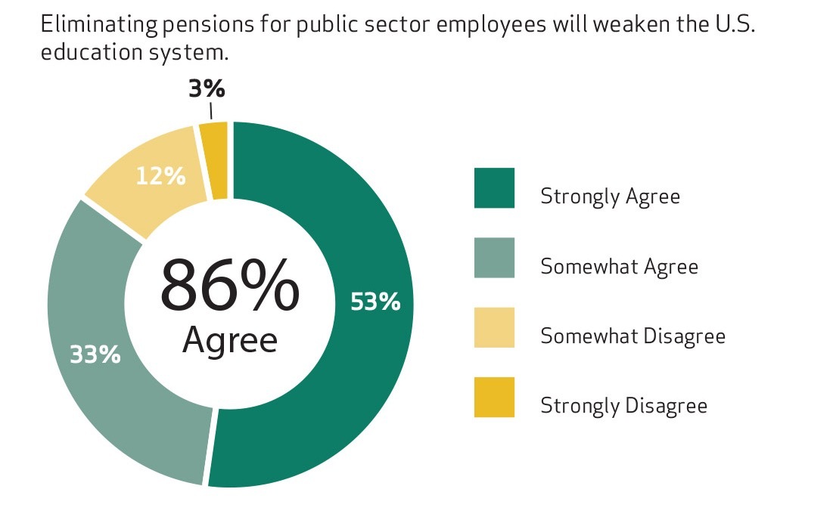
86% of Millennials in state & local government say eliminating pensions will weaken public education.
39

Slide 40
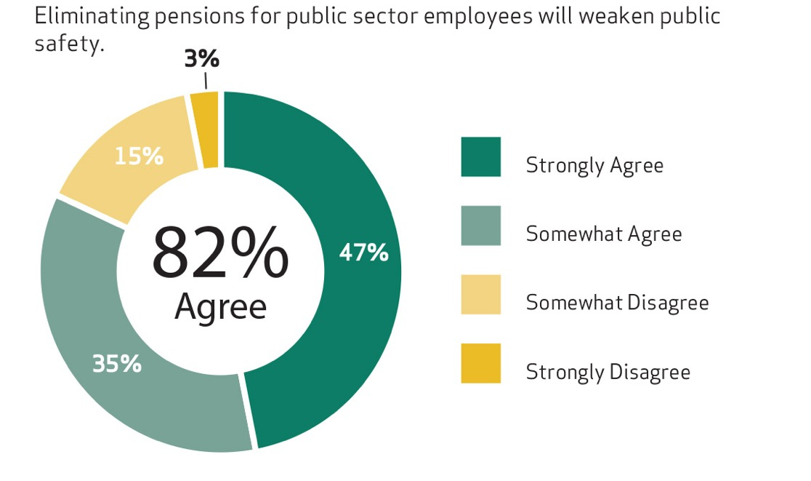
82% of Millennials in state & local government say eliminating pensions will weaken public safety.
40

Slide 41
Conclusion
This research intended to help government employers and policymakers make informed decisions related to the public workforce and employee benefits.
Given the value that Millennials place on their benefits, policymakers should use caution when modifying benefits, as such changes could have the unintended consequence of driving Millennials out the door and harming public services.

