Slide 1
The Cost of Stability: A Case Study
Andy Blough
Chief Actuary
March 1, 2022

Slide 2
The Cost of Stability: A Case Study
The funding policy described in our submitted paper is a simplified version of the policy currently used in the Indiana Public Retirement System (INPRS)
Policy was originally adopted in 2014, although some elements predate that adoption
Originally based on California Actuarial Advisory Panel paper, but many of those recommendations are mirrored in the CCA’s Actuarial Funding Policies and Practices for Public Pension Plans

Slide 3
Cost Method and Asset Smoothing Method
INPRS uses Entry Age Normal Cost Method, same as the hypothetical plan
INPRS uses an asset smoothing method to even out market fluctuations
Asset gains and losses are smoothed over five years
20% corridor around the market value of assets

Slide 4
Amortization Policy
Gains and losses, assumption and method changes, and plan provision changes are all amortized over time
The gains and losses from all sources are amortized as follows:
If the plan transitions from below 100% funded to above 100% funded or vice versa, the prior amortization layers are cleared, and the amortization restarts according to the above rules
Funded Status < 100% | Funded Status > 100%
20-year amortization period | 30-year amortization period
Layered | Single Layer
Closed | Open
Level dollar | Level dollar

Slide 5
Contribution Policy
Contributions are set as a percent of payroll
The Actuarially Determined Contribution (ADC) is equal to the normal cost rate of the plan plus any unfunded or surplus amortization
The final employer contribution rate remains at the greater of the most recent ADC or the prior year’s rate until the plan reaches 105% funded
Once the plan reaches 105% funded, the contribution rate will decrease 25% of the difference between the prior year’s contribution rate and the current year’s ADC

Slide 6
Transition or Other Issues
Policy model may not be appropriate for poorly funded plans or very weak sponsors
Policy is designed for open plans. If a plan is closed it may require a shorter amortization period.
Recommend retaining any level-dollar amortization bases, but removing any percent of pay amortization bases
There may be a delay between valuation results and contribution rates go into effect

Slide 7
Performance of this policy?
Submitted policy is close enough to INPRS’s existing policy that we will look at INPRS’s experience with the policy as a proxy
What is different?
Some items specific to Indiana law and plan history
When over 105% funded, employer contributions currently blend 25% of the way to the normal cost, not 25% of the way to the ADC
A provision where contributions are forced to equal the normal cost if over 120% funded

Slide 8
Contribution and ADC History

Slide 9
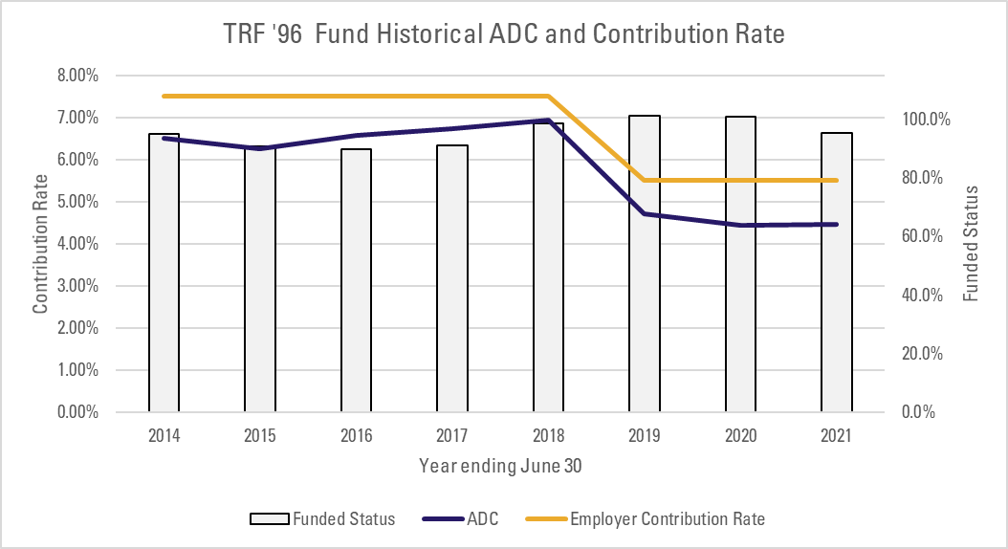
Contribution and ADC History

Slide 10
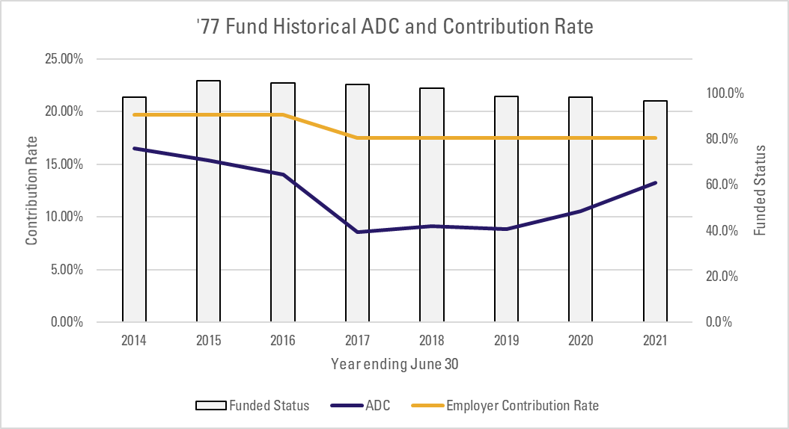
Contribution and ADC History

Slide 11
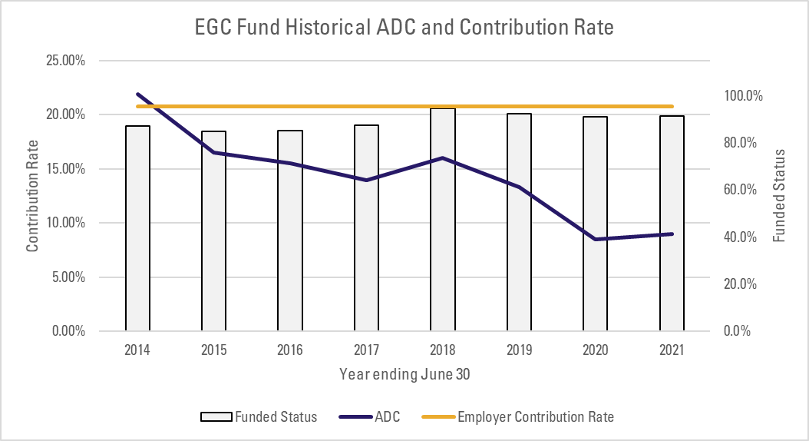
Contribution and ADC History

Slide 12
Pros of this Policy
Benefit security, by contributing at least the ADC
Contribution levels above the ADC and funding above 100% leave a buffer for adverse experience and generate stability
Accelerated funding when contributing above the ADC
Because all amortizations are level-dollar, there is no concern for negative amortization
Transparency
Publicly posted
Regularly discussed at public meetings

Slide 13
Cons of this Policy
Some stakeholders may view the stabilization mechanism as overcharging employers
Benefit improvements can appear to have no cost if they increase the ADC but not enough to increase the employer contribution rate
Results in a funded percentage over 100%, which can lead to pressure for benefit improvements or contribution reductions
More rapid funding puts additional funding burden on the current generation of members and taxpayers

Slide 14
About the Authors
Andy Blough, FSA, EA, MAAA, FCA, is the Chief Actuary of the Indiana Public Retirement System (INPRS). At INPRS, Andy routinely provides subject matter expertise on retirement actuarial matters to system staff, members of the INPRS Board of Trustees, state legislators, and others in the Indiana government. Andy also serves as the Vice Chair of the American Academy of Actuaries’ Public Pensions Committee and is a member of the Society of Actuaries’ Retirement Plans Experience Committee. Before joining INPRS, Andy was a consulting actuary with Buck focusing on single-employer private-sector pension plans. Andy has a B.A. in Mathematics and Economics from Ball State University.
Seth Stock is a Senior Actuarial Analyst at the Indiana Public Retirement System (INPRS). Before joining INPRS Seth was an actuarial analyst at Mercer, focusing on single-employer OPEB plans. Seth has a B.S. in Mathematical Economics and an M.S. in Actuarial Science from Ball State University, as well as an MBA from the University of Indianapolis

