Slide 1
Strategic Outlook and Tactical Opportunities
NIRS Annual
Meeting
2022
Jim McDonald
Chief Investment Strategist
For Use with Institutional Investors and Financial Professionals Only. Not For Retail Use.

Slide 2


Foundational to Our Asset Allocation Process
Strategic Outlook
Tactical Outlook
TIME HORIZON
5 years+
FREQUENCY
Annual
OUTPUT
Long-term asset class forecasts and strategic portfolio recommendations
TIME HORIZON
12 months
FREQUENCY
Weekly/monthly
OUTPUT
Tactical interest rate, credit spread and asset class forecasts, tactical portfolio recommendations
Notes:
Speaker:

Slide 3
A 10% Correction Was Overdue
Source: Northern Trust Global Asset Allocation, Bloomberg. X% (X being 5, 10, and 20%) correction on the S&P 500 is defined as a decline of X% from recent peak. A correction of X% is still occurring until the market increases X% from the trough. Data through 2/25/2022. Past performance does not guarantee future results.

Slide 4
Buy Signals are More Clear than Sell Signals
No signal
Source: Northern Trust Asset Management, Bloomberg. Data for S&P 500 Index. Median returns using daily data from 1/31/1990 through 8/31/2021.

Slide 5
Where Inflation Matters: Earnings and Rates
Source: Northern Trust Asset Management, Bloomberg. Bloomberg consensus 12-month earnings estimates indexed on 1/1/2021. Data from 12/31/2020 through 2/4/2022. It is not possible to invest directly in any index

Slide 6
Inflation in Developed Equities, Real Assets
2021 RETURNS (%)
 | Risk control ASSETS |  |  |  | Risk assets
 | Fixed Income |  |  |  |  |  | Equities |  |  | Real Assets
 | Cash | Municipal Bonds | Inv. Grade | TIPS | High Yield | EM Debt | U.S. | Dev. Ex-U.S. | EM Markets | Nat. Res | Gbl. Real Estate | Gbl. Listed Infra.
2021 | 0.0 | 1.5 | -1.5 | 6.0 | 5.3 | -8.7 | 26.1 | 12.9 | 0.1 | 25.2 | 23.3 | 11.9
2020 | 0.5 | 5.2 | 7.5 | 11.0 | 7.0 | 2.7 | 21.1 | 8.8 | 18.8 | 0.7 | -8.0 | -5.8
5 Year | 1.1 | 4.2 | 3.6 | 5.3 | 6.3 | 2.8 | 18.1 | 10.4 | 10.4 | 9.6 | 8.7 | 7.8
Source: Northern Trust Asset Management, Bloomberg. Five-year annualized data from December 31, 2016 to December 31, 2021. Past performance is no guarantee of future results.

Slide 7
Interest Rate Curves Are on the Rise – Will It Last?
Source: Northern Trust Asset Management, Bloomberg. Data as of 6/30/2021. Past performance does not guarantee future results.

Slide 8
Fed Forecasting Is More Miss Than Hit
NUMBER OF FED RATE HIKES/CUTS BY CALENDAR YEAR
Year | Forecasted¹ | Actual²
2014 | 0 | 0
2015 | +4 | +1
2016 | +3 | +1
2017 | +3 | +3
2018 | +3 | +4
2019 | +1 | -3
2020 | -1 | -4
2021 | 0 | 0
2022 | +3 | ???
Source: Northern Trust Asset Management, Bloomberg, Federal Reserve, as of 12/31/2021.
1 Forecasted number of 25 bps Fed funds hikes or cuts; Source: FOMC Summary of Economic Projections, beginning of each calendar year
2 Actual number of 25 bps Fed funds hikes or cuts, end of each calendar year; Source: Bloomberg

Slide 9
A Natural Wind Down
The Fed balance sheet can normalize without selling
FED BALANCE SHEET REDUCTION* ($B)
Source: Northern Trust Asset Management, Bloomberg, New York Fed. *Assumes MBS paydowns continue at current rate, and no purchases, reinvestments and/or sales of Treasuries (to model the balance sheet reduction without selling assets).

Slide 10
Foreign Lid on U.S. Interest Rates
FOREIGN INVESTOR IN U.S. TREASURIES
10-year pickup/loss for foreign investor: -1 bp
10-year pickup/loss for foreign investor: +55 bps
10-year pickup/loss for foreign investor: +30 bps
Source: Northern Trust Asset Management, Bloomberg. Data as of 2/28/2022.

Slide 11
Hike Impact: Early Headwind Turns to Momentum
Source: Northern Trust Asset Management, Bloomberg. S&P 500 returns for Fed rate hikes on 2/4/1994, 6/30/1999, 6/30/2004 and 12/16/2015. It is not possible to invest directly in any index.

Slide 12
Riskier Assets Outperform when Fed Hiking
Source: Northern Trust Asset Management, Bloomberg. One-year % average returns shown for periods dating back to 1987 in which the Federal Reserve raised its policy rate (1987, 1988, 1994, 1997, 1999, 2004 and 2015). Some asset classes have insufficient data for every period, in which case the average of the available periods is used. Due to data limitations, price returns used for equity indexes and total returns used for all others. Average one-year return shown in parenthesis. It is not possible to invest directly in any index.

Slide 13
Tactical asset allocation outlook
northerntrust.com | © 2022 Northern Trust
13

Slide 14
Ukraine Invasion Hurts Growth Outlook, Raises Inflation Risk
For Financial Professional-Use Only. Source: Northern Trust Investment Strategy. Allocations above reflect Northern Trust's Perpetual Capital Model (Moderate risk profile).Tactical recommendations (in the form of over/under/equal weights) are displayed in the bar chart. Allocations as of 2/24/2022. SAA = Strategic Asset Allocation. TAA = Tactical Asset Allocation. *Note: Due to illiquid nature of Alternative asset classes, Northern Trust does not make tactical recommendations.

Slide 15
Key Risk Cases to Watch
Persistent High Inflation
China Disruption
Underlying inflationary pressures continue over the next year, forcing the Fed into a materially more aggressive policy response — resulting in a challenging environment for both stocks and bonds.
A China policy miscalculation harms global economic functioning as it deals with a number of issues from the pandemic to energy shortages to financial stability and the property sector.

Slide 16
strategic asset allocation outlook
northerntrust.com | © 2022 Northern Trust
16

Slide 17






What to Watch in the Years Ahead
Reversion to Mediocrity
Sticking to Stuckflation
Monetary Activism
Seeking Tech Independence
Reaching Climate Consensus
The Evolving Capitalist
Notes:
Speaker:

Slide 18
Tough Shoes to Fill
For Financial Professional-Use Only. Source: Northern Trust Asset Management, Bloomberg. Annualized return data in local currency from 6/30/2016 to 6/30/2021. Past performance does not guarantee future results.
Notes:
Speaker:

Slide 19
Pension Portfolio Frontier Shift
5-YEAR EXPECTED RETURN ON ASSETS 2022 VS. 2021 AND 2020 (%)
2020 2021 2022
6.0
20LH
30LH
40LH
5.5
50LH
20LH
60LH
30LH
50LH
40LH
5.0
70LH
60LH
80LH
30LH
20LH
70LH
40LH
4.5
90LH
80LH
50LH
60LH
90LH
70LH
4.0
80LH
90LH
3.5
0.0
2.0
4.0
6.0 8.0
Surplus Volatility (%)
10.0
12.0
14.0
Source: Return and volatility assumptions from Northern Trust Capital Market Assumptions: Five-Year Outlook Editions: 2022, 2021, 2020. Surplus volatility assumes plan duration of 14 and funded status of 100.
Notes:
Speaker:

Slide 20
Illiquid Asset Classes Have Higher Sharpe Ratios
5-YEAR EXPECTED ASSET CLASS SHARPE RATIO
0.51
0.28 | 0.33 | 0.35 | 0.35 | 0.37 | 0.38
Global Equities | Global Listed Infrastructure | Private Real Estate | US High Yield | Private Equity | Emerging Markets Debt | Private Debt
Source: Return and volatility assumptions from Northern Trust Capital Market Assumptions: Five-Year Outlook Editions: 2022, 2021, 2020.
Notes:
Speaker:

Slide 21
Few Asset Classes Still Have Relatively High Returns
EXPECTED RETURNS FOR LAGGARDS AND ILLIQUID VS TRADITIONAL ASSET CLASSES
2022 Expected Returns
7.1
7.6
5.3
5.5
4.0
4.3
4.5
3.2
3.5
U.S. Long Gov | U.S. Long | U.S. Equity | Developed | Emerging | U.S. High Yield Private Real | Infra- | Private Equity
 | Credit |  | Market Equity | Market Equity | Estate | structure
2022 Expected Returns | 3.2 | 4.0 | 4.3 | 4.5 | 5.3 | 3.5 | 7.1 | 5.5 | 7.6
2022 Volatility | 11.2 | 9.8 | 14.8 | 15.3 | 21.0 | 9.1 | 17.5 | 15.5 | 19.8
Source: Return and volatility assumptions from Northern Trust Capital Market Assumptions: Five-Year Outlook Editions: 2022, 2021, 2020.
Notes:
Speaker:

Slide 22
?
QUESTIONS
northerntrust.com | © 2022 Northern Trust
22

Slide 23
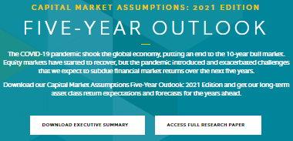
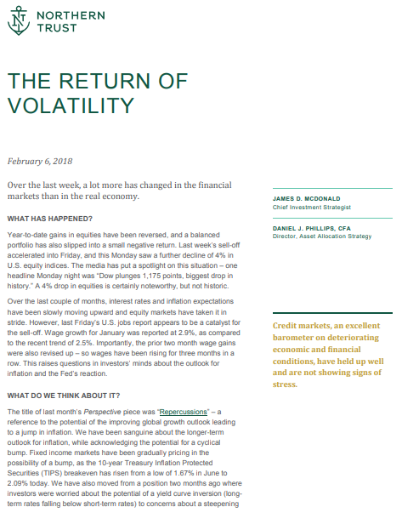

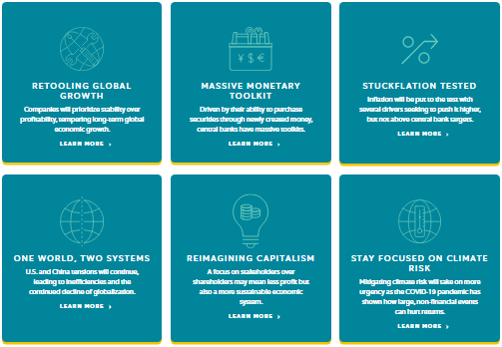
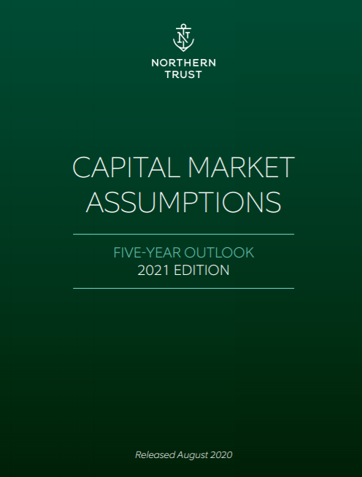
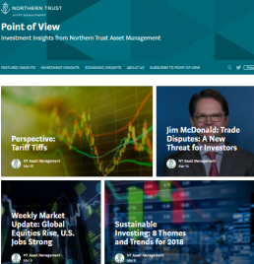
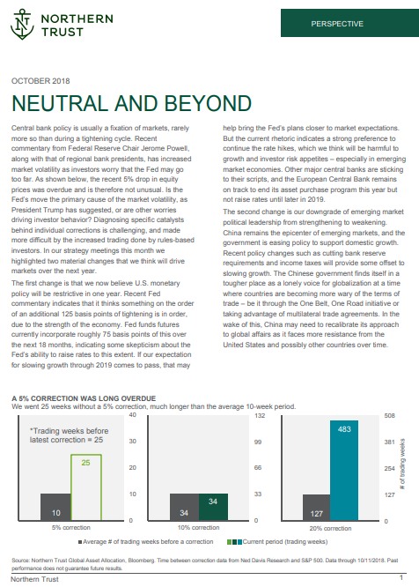

Accessing Our Global Investment Insights
INVESTMENT STRATEGY COMMENTARY
FIVE-YEAR
OUTLOOK
MARKETSCAPE Meaningful Insights in
Less Than 3 Minutes
Point of View
Blog
Pointofview.
northerntrust.com
BLOG
Timely Market
Perspectives
Perspective Monthly Tactical Updates
Webinars Live
& On Demand

Slide 24
Important Information
The information contained herein is intended for use with current or prospective clients of Northern Trust Investments, Inc. The information is not intended for distribution or use by any person in any jurisdiction where such distribution would be contrary to local law or regulation. Northern Trust and its affiliates may have positions in and may effect transactions in the markets, contracts and related investments different than described in this information. This information is obtained from sources believed to be reliable, and its accuracy and completeness are not guaranteed. Information does not constitute a recommendation of any investment strategy, is not intended as investment advice and does not take into account all the circumstances of each investor. Opinions and forecasts discussed are those of the author, do not necessarily reflect the views of Northern Trust and are subject to change without notice.
This report is provided for informational purposes only and is not intended to be, and should not be construed as, an offer, solicitation or recommendation with respect to any transaction and should not be treated as legal advice, investment advice or tax advice. Recipients should not rely upon this information as a substitute for obtaining specific legal or tax advice from their own professional legal or tax advisors. References to specific securities and their issuers are for illustrative purposes only and are not intended and should not be interpreted as recommendations to purchase or sell such securities. Indices and trademarks are the property of their respective owners. Information is subject to change based on market or other conditions.
All securities investing and trading activities risk the loss of capital. Each portfolio is subject to substantial risks including market risks, strategy risks, adviser risk and risks with respect to its investment in other structures. There can be no assurance that any portfolio investment objectives will be achieved, or that any investment will achieve profits or avoid incurring substantial losses. No investment strategy or risk management technique can guarantee returns or eliminate risk in any market environment. Risk controls and models do not promise any level of performance or guarantee against loss of principal. Any discussion of risk management is intended to describe Northern Trust’s efforts to monitor and manage risk but does not imply low risk.
Past performance is no guarantee of future results. Performance returns and the principal value of an investment will fluctuate. Performance returns contained herein are subject to revision by Northern Trust. Comparative indices shown are provided as an indication of the performance of a particular segment of the capital markets and/or alternative strategies in general. Index performance returns do not reflect any management fees, transaction costs or expenses. It is not possible to invest directly in any index. Net performance returns are reduced by investment management fees and other expenses relating to the management of the account. Gross performance returns contained herein include reinvestment of dividends and other earnings, transaction costs, and all fees and expenses other than investment management fees, unless indicated otherwise. For additional information on fees, please refer to Part 2a of the Form ADV or consult a Northern Trust representative.

Slide 25
Important Information
Forward-looking statements and assumptions are Northern Trust’s current estimates or expectations of future events or future results based upon proprietary research and should not be construed as an estimate or promise of results that a portfolio may achieve. Actual results could differ materially from the results indicated by this information.
Capital Market Assumption (CMA) model expected returns do not show actual performance. CMA model expected returns are based on IPC Forecasted Returns and reflect Northern Trust’s Investment Policy Committee’s (IPC) forward-looking annual capital market assumptions. The Capital Market Assumptions Working Group (CMAWG), a subset of IPC members, publishes its assumptions as a white paper report. Forecasted returns are for average annual returns (geometric basis). Five year forecasts are developed annually; most recent forecasts released 8/11/2021. The model cannot account for the impact that economic, market, and other factors may have on the implementation and ongoing management of an actual investment strategy. Model outcomes do not reflect actual trading, liquidity constraints, fees, expenses, taxes and other factors that could impact the future returns. The model assumptions are passive only. References to expected returns are not promises or even estimates of actual returns an investor may achieve. The assumptions, views, techniques and estimates set out are provided for illustrative purposes only. Forecasts of financial market trends that are based on current market conditions constitute CMAWG judgment and are subject to change without notice. “Expected” or “alpha” return estimates are subject to uncertainty and error. The ability to achieve similar outcomes is subject to risk factors over which Northern Trust may have no or limited control.
If presented, hypothetical portfolio information provided does not represent results of an actual investment portfolio but reflects representative historical performance of the strategies, funds or accounts listed herein, which were selected with the benefit of hindsight. Hypothetical performance results do not reflect actual trading. No representation is being made that any portfolio will achieve a performance record similar to that shown. A hypothetical investment does not necessarily take into account the fees, risks, economic or market factors/conditions an investor might experience in actual trading. Hypothetical results may have under- or over- compensation for the impact, if any, of certain market factors such as lack of liquidity, economic or market factors/conditions. The investment returns of other clients may differ materially from the portfolio portrayed. There are numerous other factors related to the markets in general or to the implementation of any specific program that cannot be fully accounted for in the preparation of hypothetical performance results. The information is confidential and may not be duplicated in any form or disseminated without the prior consent of Northern Trust.

Slide 26
Important Information
This information is intended for purposes of Northern Trust marketing of itself as a provider of the products and services described herein and not to provide any investment recommendations or advice within the meaning of the Department of Labor’s Final Fiduciary Rule (29 CFR §2510.3-21). Northern Trust is not undertaking to provide impartial investment advice or give advice in a fiduciary capacity to the recipient of these materials. To the extent that the recipient of these materials has authority to act on behalf of a benefit plan that is subject to Title I of the Employee Retirement Income Security Act of 1974, as amended (“ERISA”), Northern Trust provides information with the understanding that the recipient: (1) is a fiduciary under ERISA with respect to any plan transaction(s) contemplated herein and is responsible for exercising independent judgment in evaluating any such transaction(s); (2) is independent of Northern Trust; (3) is a bank or similarly regulated financial institution, insurance carrier, registered investment adviser, registered broker-dealer, or a plan fiduciary that holds, or has under management or control, total assets of at least $50 million; (4) is capable of evaluating investment risks independently, both in general and with regard to particular transactions and investment strategies. Please advise Northern Trust immediately if any of the foregoing understandings is incorrect. Further, Northern Trust and its affiliates receive fees and other compensation in connection with the products and services described herein as well as for custody, fund administration, transfer agent, investment operations outsourcing and other services rendered to various proprietary and third party investment products and firms that may be the subject of or become associated with the services described herein.
Northern Trust Asset Management is composed of Northern Trust Investments, Inc. Northern Trust Global Investments Limited, Northern Trust Fund Managers (Ireland) Limited, Northern Trust Global Investments Japan, K.K, NT Global Advisors, Inc., 50 South Capital Advisors, LLC, Belvedere Advisors LLC and investment personnel of The Northern Trust Company of Hong Kong Limited and The Northern Trust Company.
© 2022 Northern Trust Corporation. Head Office: 50 South La Salle Street, Chicago, Illinois 60603 U.S.A.

