Slide 1


The Risks and Opportunities of Investing in Emerging Markets
Webinar

Slide 2

Agenda
Speaker Introductions
Presentation
Q&A

Slide 3


Speakers
Ben Durrant
Investment Manager, Emerging Markets Equity Team
Baillie Gifford
Tyler Bond
Research Director
National Institute on Retirement Security

Slide 4
Important information and risk factors
This presentation has been prepared for use by professional advisers and intermediaries only. It is not intended for use by retail clients.
Baillie Gifford Overseas Limited is wholly owned by Baillie Gifford & Co. Baillie Gifford Overseas Limited provides investment management and advisory services to non-UK clients. Both are authorized and regulated by the Financial Conduct Authority. Baillie Gifford Overseas Limited is registered with the SEC in the United States of America.
Baillie Gifford International LLC is wholly owned by Baillie Gifford Overseas Limited; it was formed in Delaware in 2005 and is registered with the SEC. It is the legal entity through which Baillie Gifford Overseas Limited provides client service and marketing functions in North America.
The Manager is not resident in Canada, its head office and principal place of business is in Edinburgh, Scotland. Baillie Gifford Overseas Limited is regulated in Canada as a portfolio manager and exempt market dealer with the Ontario Securities Commission ('OSC'). Its portfolio manager licence is currently passported into Alberta, Quebec, Saskatchewan, Manitoba and Newfoundland & Labrador whereas the exempt market dealer licence is passported across all Canadian provinces and territories. Baillie Gifford International LLC is regulated by the OSC as an exempt market and its licence is passported across all Canadian provinces and territories. Baillie Gifford Investment Management (Europe) Limited (‘BGE’) relies on the International Investment Fund Manager Exemption in the provinces of Ontario and Quebec.
Baillie Gifford & Co claims compliance with the Global Investment Performance Standards (GIPS®). All performance data presented is supplementary to an appropriate compliant composite presentation. An example of a compliant composite presentation has been included for your reference. A complete list of the Firm’s composites and performance results is available on request.
This presentation contains information on investments which does not constitute independent research. Accordingly, it is not subject to the protections afforded to independent research and Baillie Gifford and its staff may have dealt in the investments concerned.
All information is current and sourced from Baillie Gifford & Co unless otherwise stated.
Past Performance
Past performance is not a guide to future returns. Changes in investment strategies, contributions or withdrawals may materially alter the performance, strategy and results of the portfolio.
Material market or economic conditions will have an impact on investment results. The returns presented in this document are gross of fees unless otherwise stated and reflect the reinvestment of dividends and interest.
All investment strategies have the potential for profit and loss.
Historical performance results for investment indexes and/or categories, generally do not reflect the deduction of transaction costs and/or custodial charges or the deduction of an investment management fee, the incurrence of which would have the effect of decreasing historical performance results.
It should not be assumed that recommendations/transactions made in the future will be profitable or will equal performance of the securities mentioned.
Stock Examples
Any stock examples, or images, used in this presentation are not intended to represent recommendations to buy or sell, neither is it implied that they will prove profitable in the future. It is not known whether they will feature in any future portfolio produced by us.
Any individual examples will represent only a small part of the overall portfolio and are inserted purely to help illustrate our investment style.
Principal Office: Calton Square, 1 Greenside Row, 780 Third Avenue, 43rd Floor, New York, NY 10017
Edinburgh EH1 3AN, Scotland Telephone: (212) 319 4633 bailliegifford.com
Telephone: +44 (0) 131 275 2000 bailliegifford.com

Slide 5
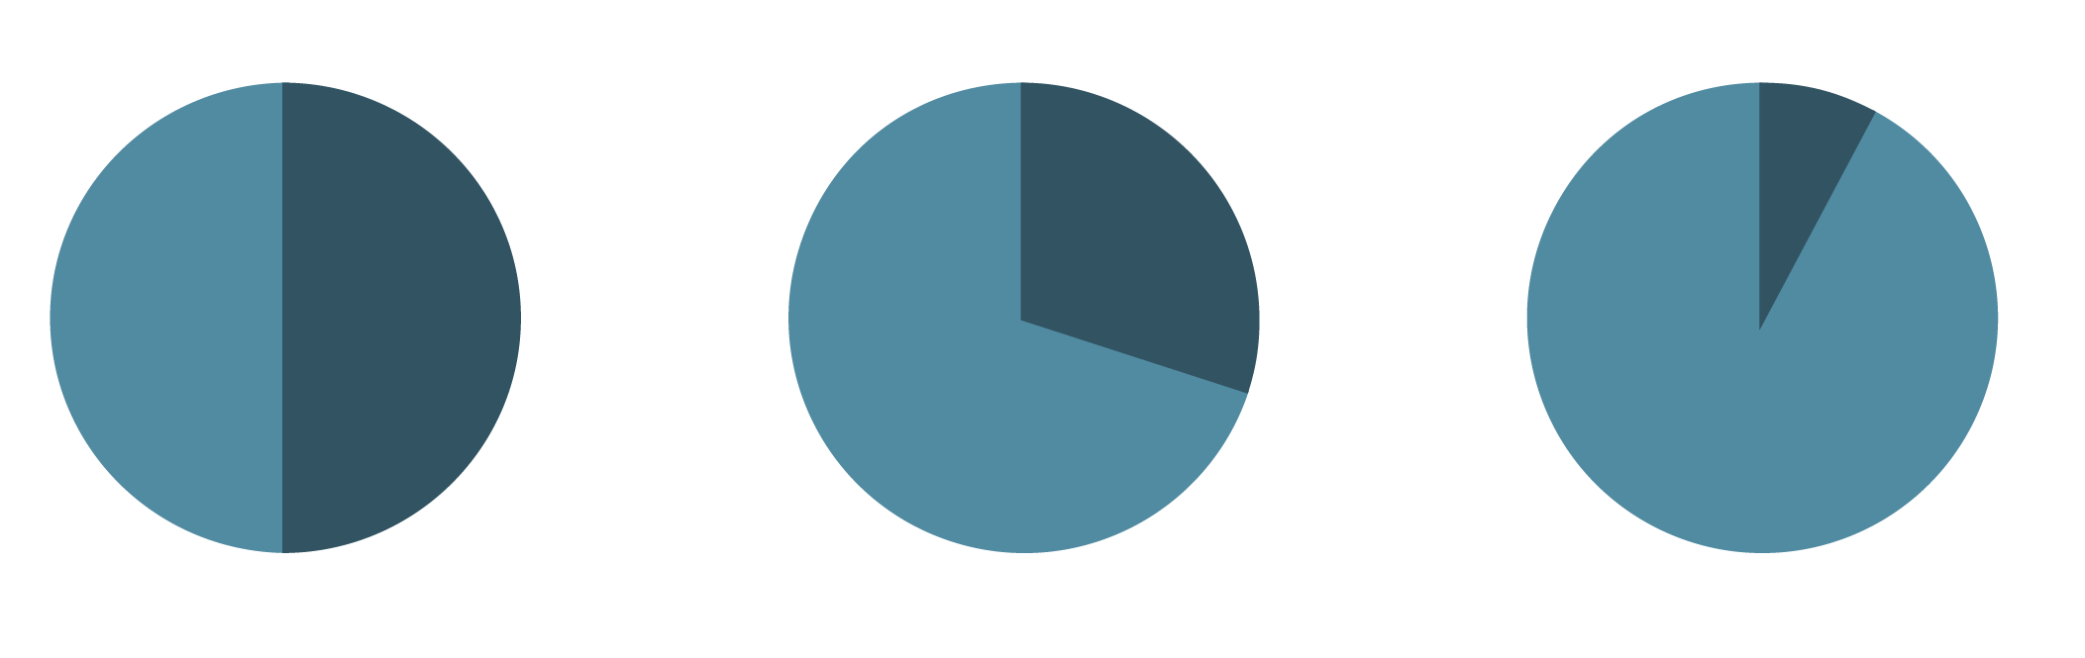
Emerging Markets matter – more than the MSCI thinks
>50%
>30%
<10%
of the world’s population¹
share of
global GDP²
of MSCI’s
global index³
© Image credits 6pt Arial and always rotated 90 degrees
¹United Nations, Population Division, Department of Economic and Social Affairs
²The World Bank, World Development Indicators
³Bloomberg

Slide 6
A disappointing decade
… but still valuable over the long-run
As at 30 September 2023.
Emerging Markets vs Developed Markets
Source: Longtermtrends, MSCI. Calculated using monthly data from 31 December 1987 to 30 April 2023, in USD.
All investment strategies have the potential for profit and loss. Past performance is not a guide to future returns
.

Slide 7
All risk, no reward?
Chinese economic challenges
Rising interest rates
Global recession fears
Russia – Ukraine
Israel – Hamas
US – China tensions
… and the list could go on!

Slide 8
The possibilist
‘It’s easy to be aware of all the bad things happening in the world. It’s harder to know about the good things: billions of improvements that are never reported.
Don’t misunderstand me , I’m not talking about some trivial positive news to supposedly balance out the negative. I’m talking about the fundamental improvements that are world-changing but are too slow, too fragmented or too small one-by-one to ever qualify as news.
I’m talking about the secret silent miracle of human progress.’
Hans Rosling, ‘Factfulness’

Slide 9

Key takeaways
It is different this time
Net zero underpins the next growth cycle
Innovation and growth is moving beyond China
Demographics are finally kicking in
China is more nuanced than some headlines suggest

Slide 10
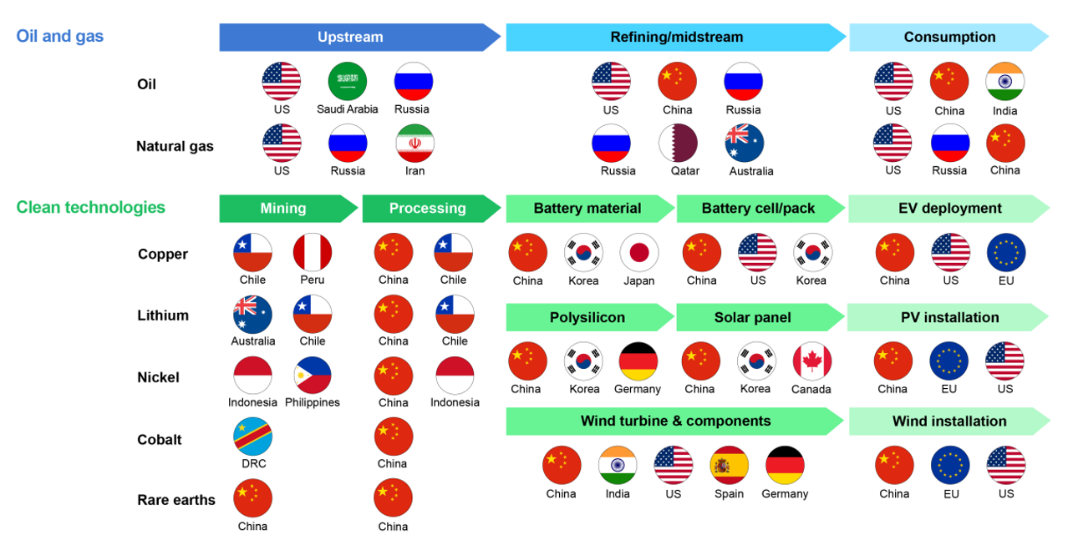
Clean and secure energy: the new world order
Source: IEA.
Notes: DRC = Democratic Republic of the Congo; EU = European Union; US = United States; Russia = Russian Federation; China = People’s Republic of China.
Largest producers and consumers are noted in each case to provide an indication, rather than a complete account.

Slide 11
EM is vital to the energy transition
Growth in demand for selected minerals from clean energy technologies by scenario, 2040 relative to 2020
Share of top three producing countries in selected minerals, 2019
Source: IEA. Licence CC by 4.0.
Source: IEA

Slide 12
Cities as engines of innovation
Population growth in select cities, 2010 - 2020
‘In America and Europe, cities speed innovation by connecting their smart inhabitants to each other, but cities play an even more critical role in the developing world: they are gateways between markets and cultures. In the nineteenth century, Mumbai was a gateway for cotton. In the twenty-first century, Bangalore is a gateway for ideas.’
Edward Glaeser, ‘Triumph of the City’
Source: UN.

Slide 13
Innovation continues to flourish
Ex-US Unicorns created in 2021 and 2022
Source: CB Insights. A unicorn is a private company with a valuation of over $1 billion. Data as of 31 December 2022.

Slide 14
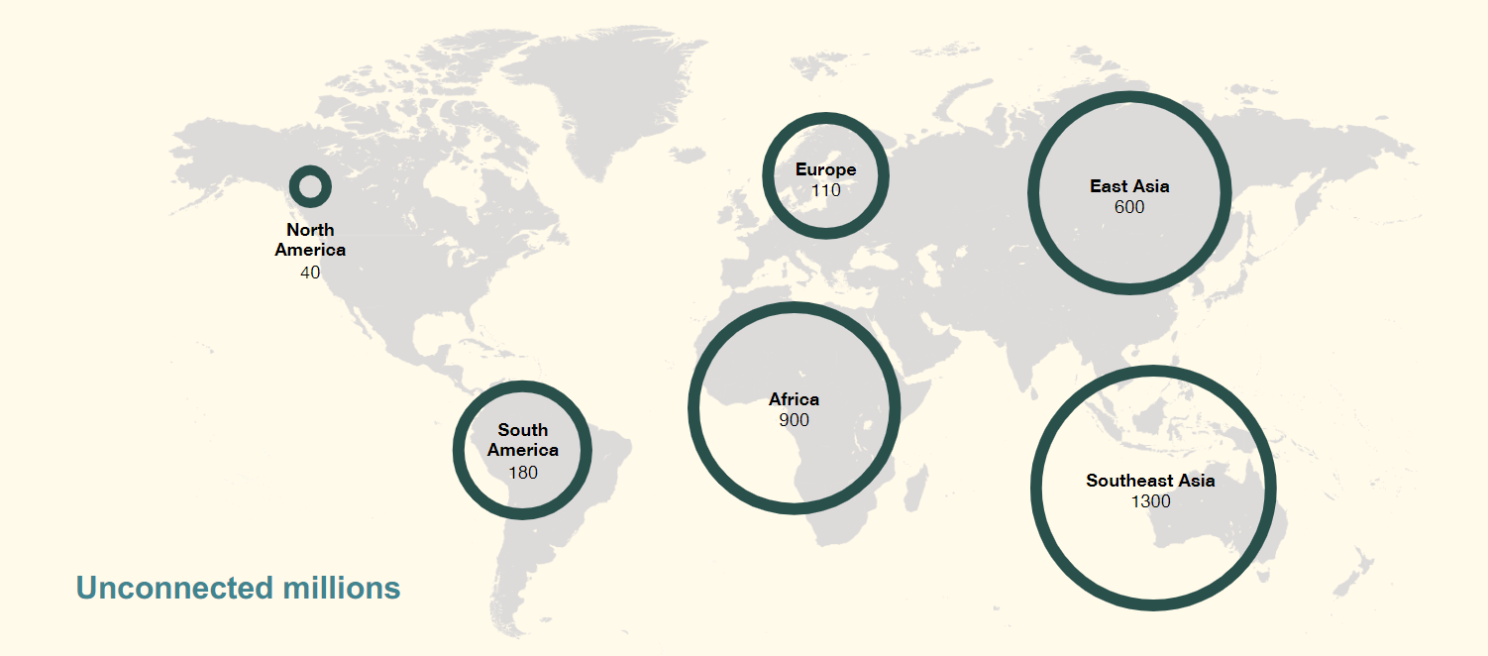
The internet’s second act
Source: Visual Capitalist published August 2020.

Slide 15
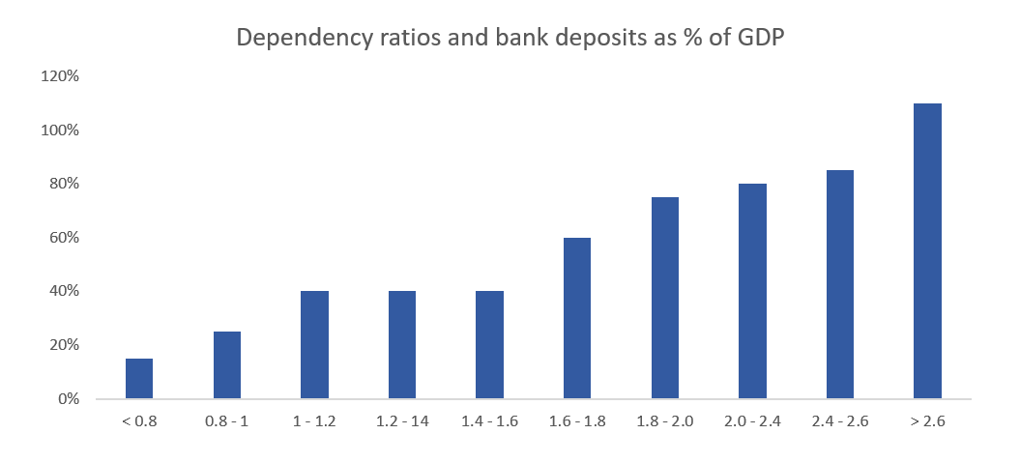
Hitting the demographic sweet spot
Source: UN, World Bank, Renaissance Capital.

Slide 16
Case study: Brazil
Per-capita $ GDP in Brazil has fallen by over 30% from its 2011 peak. Might this ‘lost decade’ be clawed back sooner than anyone expects?
Source: IMF, World Bank, Bloomberg

Slide 17
How do you solve a problem like China?
Market Concerns
Governance and disclosure
Sustainability
Access
Role of the state
Baillie Gifford approach
Do your research
Engage thoughtfully
On the ground presence
Additional perspectives

Slide 18
Shifting preferences and values
‘A phrase used by young Chinese is ‘a generation gap every five years’ (some have it as every three).
A child born in 1980 grew up in a China emerging from chaos and poverty; another born in 1985 won’t remember anything of or before the Tiananmen protests; a third born in 1990 in a net native.’
Alec Ash, ‘Wish Lanterns; Young Lives in New China’

Slide 19
Shifting supply chains
Exports index value growth, in USD (2009 =100)
Source: Baillie Gifford & Co, Gavekal Dragonomics/Macrobond, EM Advisors Group.

Slide 20
Why active? Why growth?
Market inefficiencies are most pronounced in EM
Grey bars show market forecasts, blue bars show historic returns
US Stocks – Range of EPS 3-Year CAGR EM Stocks – Range of EPS 3-Year CAGR
Source: FactSet, S&P. Based on US stocks in S&P 500. US dollars. Source: FactSet, FTSE, MSCI. Based on Emerging Markets stocks in MSCI EM Index or FTSE EM Index. US dollars.

Slide 21
Key takeaways
It is different this time
Net zero underpins the next growth cycle
Innovation and growth is moving beyond China
Demographics are finally kicking in
China is more nuanced than some headlines suggest

Slide 22

Questions

