Slide 1
How Business Process Improvement Can Help Pension Funds Streamline Success
Webinar

Slide 2
Agenda
Logistics and Introductions
Presentation
Q&A

Slide 3
Speakers
Dan Doonan
Gerard Pappa
Executive Director
National Institute on Retirement Security
Senior Consultant
Linea Solutions

Slide 4
How Business Process Improvement Can Help Pension Funds Streamline Success
NIRS Webinar
Thursday, October 17th
2:00-3:00 PM EST

Slide 5
Gerard Pappa Senior Consultant
20+ years of experience providing business process improvement and project management for healthcare, pension, and public organizations
Lean Six Sigma Master Black Belt certified
Recent work includes:
Tennessee Consolidated Retirement System
The International Union of Painters and Allied Trades
San Bernardino County Employees’ Retirement Association
Educational Employees’ Supplementary Retirement System of Fairfax County

Slide 6
Agenda
What is BPI?
Why the Process Focus?
BPI Roadmap and Methodology
Process, People and Technology
Value Add Analysis (VAA)
Solution Criteria
BPI Implementation
Process Controls and Monitoring
Summary
BPI Overview

Slide 7
What is BPI?
The practice of assessing current processes to identify improvement opportunities and applying a Continuous Improvement (CI) Cycle by:
Eliminating wasteful steps to increase process efficiencies and reduce errors to provide consistent process outputs.
Shifting roles and responsibilities of staff to better align with operational needs.
Creating a metric centric organization, relying on data to track, manage, and measure process performance for long term success.
Assess
Recommend
Implement
Monitor
Continuous Improvement
Notes:
Gerard

Slide 8
Why the Process Focus?
To see the process from start to finish as it is currently being performed.
To identify operational process challenges and pain points conducive to defining process success.
To garner buy-in from staff through engagement and empowerment.
To understand how and why work gets done to identify technology opportunities.
To identify valid business needs.
To characterize customer relationships to drive excellent customer service.
To align improvements with organizational mission vision and values to reinforce Continuous Improvement mind set for long-term success.
Blame the process, NOT the people.
Notes:
Gerard

Slide 9
BPI Roadmap
IV-Performance Monitoring and Control
III-Implementation Plan
I -Current State Process Assessment
II-BPI Recommendations

Slide 10
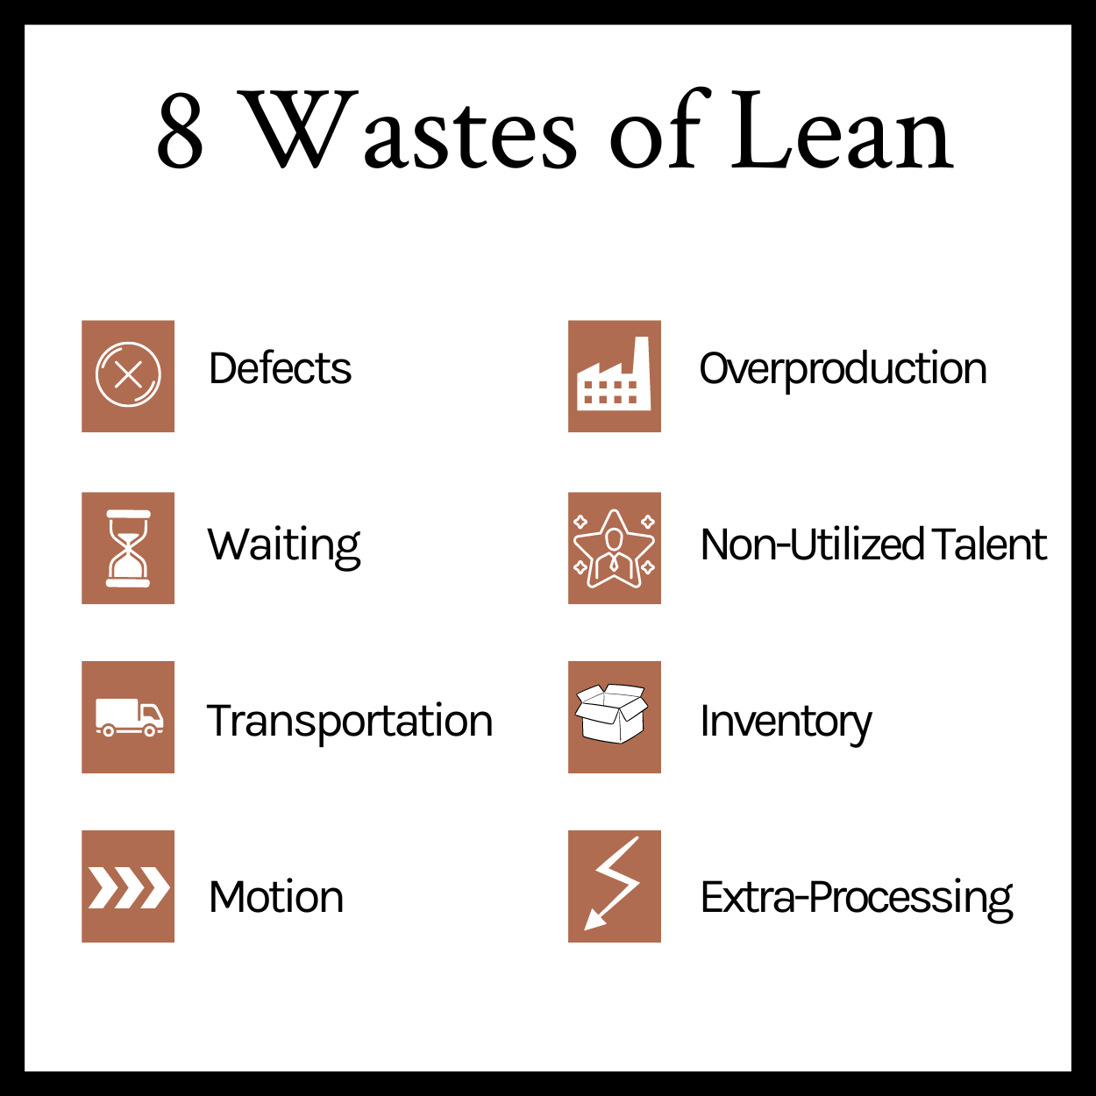
Value-Add Analysis (VAA)
A Value-Add Analysis (VAA) is a Lean Six Sigma tool used to identify waste by evaluating process activities or steps that add value to the process defined by the customer.

Slide 11
Process, People, and Technology
Process
People
Technology
Process
Develop simplified, efficient, and well-documented business processes and procedures
Eliminate manual processes, workarounds, and paper-dependency where possible

Slide 12
Process, People, and Technology
Process
People
Technology
People – Staff, Employers, Members
Improve employee engagement and strengthen company culture
Identify and implement enhancements to employer reporting process
Enhance customer service experience for members

Slide 13
Process, People, and Technology
Process
People
Technology
Better utilize current technology
Technology
Ease and reduce cost of implementing changes
Automate internal controls
Identify system enhancements and functionality

Slide 14
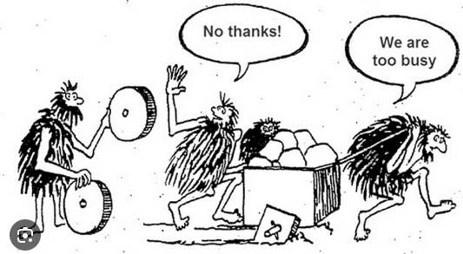
Solution(s) Criteria
Remove Showstoppers
Identify evaluation criteria
Cost
Level of effort
Level of disruption
Alignment with organizational culture and strategic vision
Notes:
Gerard

Slide 15
Pain Points, Solutions and Solution Categorization
Common Pain Points | Common Solutions | People, Process Technology
Manual data entry into system and in excel spreadsheets | Eliminate excel tracking sheet (typically multiple versions) and automate data entry | Process, Technology
Receiving applications incomplete or inaccurate | Simplify and standardize applications with consistent terminology, look, and feel Make processing online through portal available | Process, Technology
Receiving inaccurate data from employers (no validations, pension organization cleaning data) | Establish clear Employer roles and responsibilities Create employer guide for training and communication. Create data validations to alert of data differences | People, Technology
Excessive approvals | Eliminate additional approvals to streamline process | Process
Operator variation/processing is completed in many different ways | Standardize process with best practices Update process materials Train staff on new process | People, Process

Slide 16
BPI Implementation
Current State Confirmed
Current state processes confirmed by understanding people, process, and technology to determine functionality, and workforce capabilities.
Approval of Recommendations on Desired Future State
Once recommendations are approved an implementation roadmap can be created.
Implementation Plan Developed
The plan should consider level of effort, and time to implement the solutions, including testing, training, and resource availability.
Implementation Criteria
Approval of the recommendations to create an implementation plan.
Resource availability confirmed.
Metrics confirmed
Go-live date(s) confirmed
Testing timeline and feedback loop initiated
Process materials created and/or updated

Slide 17
Process Controls and Monitoring
Process Controls ensure the solution is properly implemented, documented, measured, and maintained, securing adoption by staff and the organization.
Once go-live starts a Control Plan will be activated that:
Lists all the process measures.
Documents operational
Lists the process owner
Outlines the corrective action
Detection
Detect defects within the operation
Containment
Identify defects before they move to the next operation
Prevention
Makes the occurrence of errors impossible
An ounce of prevention is worth a pound of cure. – Ben Franklin

Slide 18
Summary
A successful BPI Project will:
Remove waste by eliminating redundancy, rework, manual work, excessive hand-offs and approvals.
Challenge the status quo to identify solutions that consider operations in 3-5 years.
Identify key process metrics to create a metric centric organization, relying on data to track, manage, and measure process performance for long term success.
Notes:
Gerard

Slide 19
Establishing a CI Framework for Long-Term Success
Identify
Opportunities in the process
Plan
Process improvements
Implement
Changes
Review
Changes
The Continuous Improvement Cycle
Notes:
High value process analysis for future state
Utilize Lean Six Sigma Tool-Value Add Analysis (VAA)
Identifying waste for additional improvement opportunities (People/Process/Technology)
Understand challenges at the process step level through step level metrics (hand-offs, turn-around) time)
Challenge existing thinking to scrutinize steps to ensure there is a valid business need for each activity.
Incorporate ideas from staff and support process design that enhances their work.

Slide 20
Questions

