Slide 1

A Case Study in Pension Innovation
Lilach Frenkel
Director, Product Innovation

Slide 2

Overview
The Success of the Canadian ‘Maple’ Model Design
Evolving the Maple Model Design as a Modern DB Pension
Q&A

Slide 3

Canadian Maple Model Features
Asset Diversification
Long-time Investment Horizon
Economies of Scale
In-House Management
Independent Governance
Expert Talent

Slide 4

Canadian Maple Model Features
Asset Diversification
Long-time Investment Horizon
Economies of Scale
In-House Management
Independent Governance
Expert Talent

Slide 5
Introducing CAAT
Established in 1967
Jointly sponsored
Profit-for-members trust
Top-tier pension plan
health at 124% funded
Opened to all sectors and
provinces in 2020

Slide 6
Why Grow the CAAT Plan
Strategic Risk Management
Improve plan demographics
Diverse population
Economies of scale
Asset diversification
Expand Pension Coverage
Improve the retirement income security for Canadians
Better pensions will create a better Canada
  $1.67

Slide 7




Building DB and DC in One Plan
Secure lifetime income
Fixed cost and contribution rates
Open to all sectors: private, non-profit and broader public

Slide 8

Employer Considerations
Fixed costs and contribution rates
Administration and investments, including all regulatory compliance, are managed by CAAT
Employer and employee support through trainings, service centre and portals

Slide 9
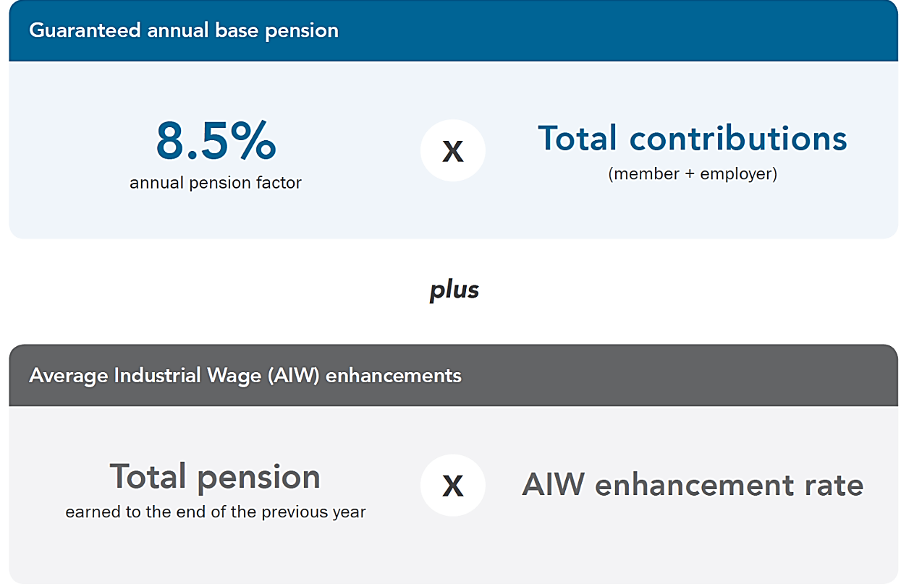
DB Innovation That Works
Increase pension factor from 8.5% to 9.5% for pensions earned on a go-forward basis
(effective January 1, 2025)
Higher benefits in the future at the same cost today

Slide 10

Accessible to workplaces across Canada
99,000+ members
440+ employers
Employers from all sectors:
  Private
  Public
  Not-for-profit

Slide 11

CAAT Continues to Innovate
GROWTHplus Investment Account launching by the end of 2024

Slide 12
Bringing DB Back to the Private Sector
Respond to needs of employers and members with a modern design
Affordable lifetime retirement income is possible leveraging design efficiencies and managing risk
Continue to innovate and evolve as Canadians’ need evolve

